Slide 1
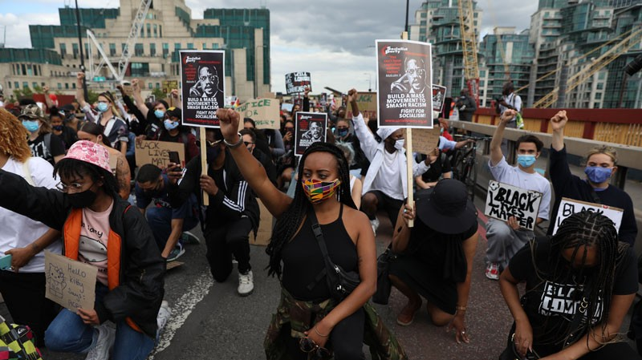
anti-racism & actionable Allyship: You, Me & Intersectionality
Shantel Thomas
BASW anti-racism lead (Uk focus)
07 July 2021

Slide 2
28 May 2021 – Anti-Racism Podcast with Mit Joyner, President of NASW https://podcasts.apple.com/gb/podcast/anti-racism/id1511140451?i=1000523288660 https://open.spotify.com/episode/4p2ozyBNNF9QBQXyQ2Pg9n 21 May 2021 - A conversation with Shantel Thomas, BASW Anti-Racism Lead https://www.basw.co.uk/media/news/2021/may/conversation-shantel-thomas-basw-anti-racism-lead 06 May 2021 - BASW member blog: The ASYE's facing discrimination https://www.basw.co.uk/media/news/2021/may/basw-member-blog-asyes-facing-discrimination 21 Apr 2021 – BASW comments as jury finds Derek Chauvin guilty of the murder of George Floyd https://www.basw.co.uk/media/news/2021/apr/basw-comments-jury-finds-derek-chauvin-guilty-murder-george-floyd 09 Apr 2021 - BASW comments on the Commission for Race and Ethnic Disparities Report https://www.basw.co.uk/media/news/2021/apr/basw-comments-commission-race-and-ethnic-disparities-report-march-2021 01 Apr 2021 - New staff join BASW as organisation steps up commitment to anti-racism and wider equality, diversity and inclusion action https://www.basw.co.uk/media/news/2021/mar/new-staff-join-basw-organisation-steps-commitment-anti-racism-and-wider-equality
Shantel Thomas
E-mail: Shantel.Thomas@basw.co.uk
Instagram: @basw_anti_racism_lead
Twitter: @ShantelThomas77
LinkedIn:
Shantel Thomas

Slide 3
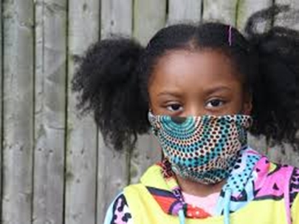
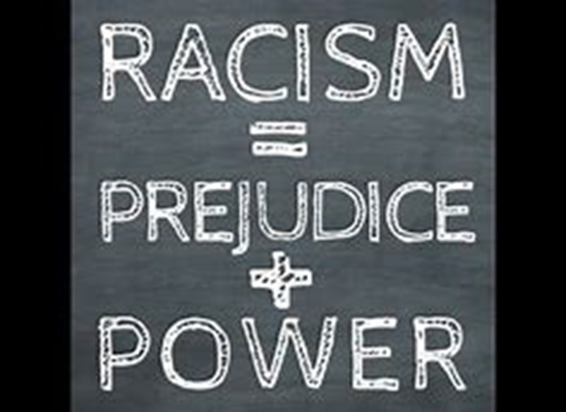
What is Racism?
The International Convention on the Elimination of All Forms of Racial Discrimination adopted this definition of racism in 1965:
“…any distinction, exclusion, restriction or preference based on race, colour, descent, or national or ethnic origin which has the purpose or effect of nullifying or impairing the recognition, enjoyment, or exercise, on an equal footing, of human rights and fundamental freedoms on the political, economic, social, cultural or any other field of public life.”
In other words, individual and institutional practices and policies based on the belief that a particular race is superior to others. This often results in depriving certain individuals and groups of civil liberties, rights, and other resources, hindering opportunities for social, educational, and political advancement.

Slide 4
What does race mean to me?…
Free writing activity

Slide 5
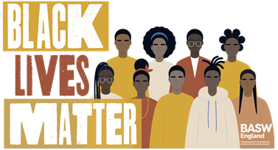
What is anti-Racism?
‘Anti-racism’ is a belief that all races and ethnic groups are equal and deserving of the same opportunities. But the most important part of anti-racism is the next step, which is to do something about the existing inequality. Anti-racism is the active dismantling of systems, privileges, and everyday practices that reinforce and normalize the contemporary dimensions of white dominance. This, of course, also involves a critical understanding of the history of ‘whiteness’ (Kendi, 2019).

Slide 6
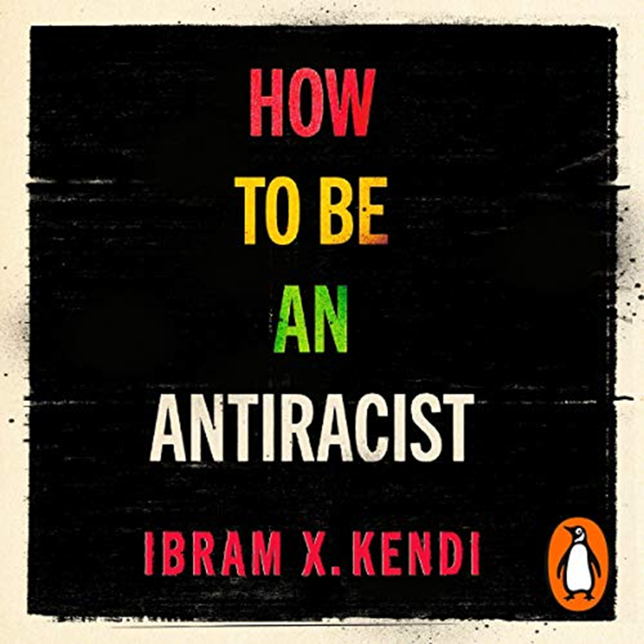
‘

Slide 7
Why is anti-Racism important?
Despite a strong rhetoric of anti-racist practice in social work over the last 30 years (Williams & Bernard, 2018), a wide range of research evidence continues to highlight inequalities in children’s, adult social care and mental health services as well as in social work education and employment.
In 2020, the re-emerging of the Black Lives Matter movement following the murder of George Floyd, and the disproportionate impact of Covid-19 on the lives of marginalised ethnic communities have heightened the need to refocus attention on anti-racism and activism in social work education and practice.

Slide 8
How to be an anti-Racist Top tips
Self-Reflection/Education
Stop saying ‘I’m not racist’
Confront racist ideas
Understand intersectionality
Champion anti-racist ideas and policies
Identify Racial Inequalities and disparities

Slide 9
Identity and intersectionality
The concept of intersectionality (Crenshaw, 1989) extends our understanding of cultural competence to include an appreciation of how one aspect of identity, such as ‘race’, can interact with other aspects of identity such as gender, sexual orientation or class, e.g. as a woman from an African-Caribbean background, I face discrimination due to both my ethnicity and my gender.
(Fletcher and Crawford, 2019)

Slide 10
Social GGRRAAACCCEEESSS
“We must heed subjugated voices because subjugation…belongs to every context of practice and power." (Ross, 1994)
The importance of being aware of, sensitive to and competent in working with issues of social difference has a rich history in the systemic and narrative practice
Exploring the effects of ‘social graces’ and peoples’ responses to social difference begins to reveal and deconstruct power
While we need to bear differences and similarities in mind in our practice, above all we need to remain curious about how others’ beliefs inform what they do and how they do it
Gender Identity
Geography
Race
Religion
Age
Ability
Appearance
Culture
Class
Colour
Education
Employment
Ethnicity
Spirituality
Sexuality
Sexual orientation
Something Else
(Burnham, 2012)

Slide 11
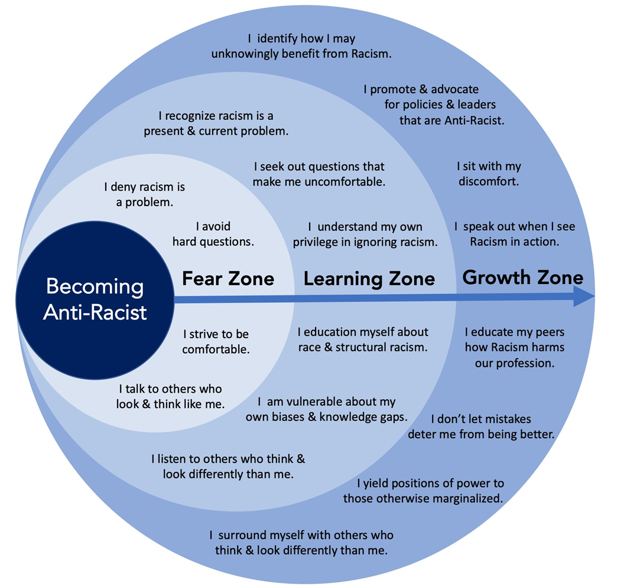
Becoming anti-racist

Slide 12
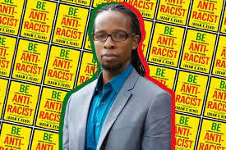
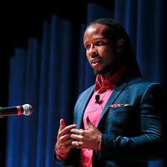
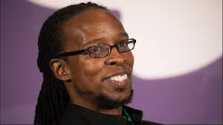
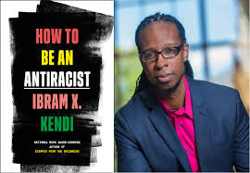
‘The heartbeat of antiracism is self-reflection, recognition, admission and fundamentally self critique…one either allows racial inequities to persevere, as a racist OR confronts racial inequities as an antiracist – there is no in-between safe space of ‘non-racist’ – the claim of ‘non-racist’ neutrality is a mask for racism’.
(Ibram X Kendi, 2019)

Slide 13
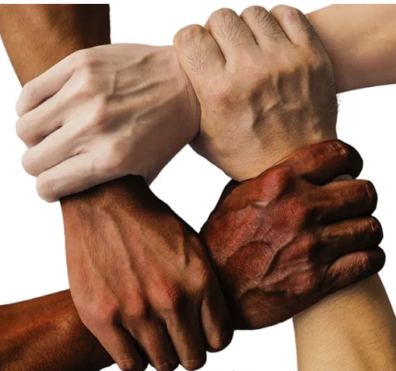
What is allyship?
What does it mean to be an ally?
The word “ally” has become an important identifier for those who want to challenge the status quo.
But, what does allyship really mean?
How does someone become an ally?
How can social workers use allyship skills to fight for social justice?

Slide 14
How to be an anti-racist ally!
Understanding Allyship: Then and Now
Self-Examination and Critical Thinking
Awareness and Education
Action – Remember Allyship is a verb
Allyship in Social Work
Develop Your Allyship Skills

Slide 15
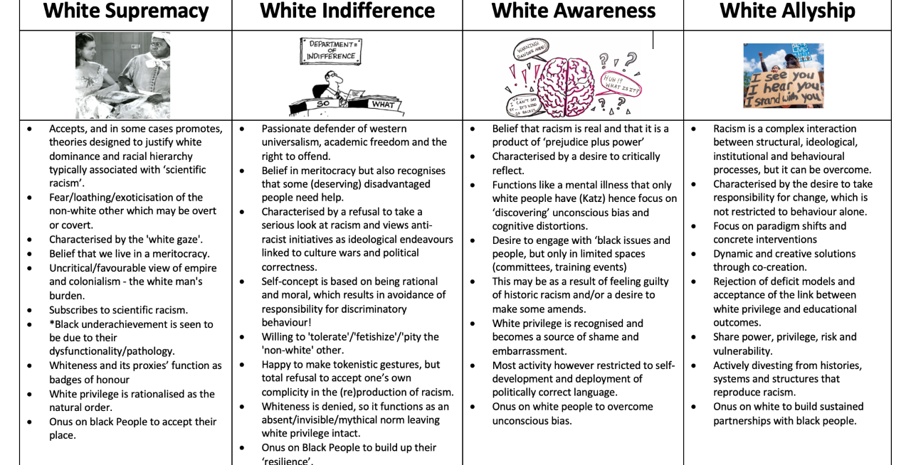

Slide 16
The things I can do to become an anti-racist ally are…
Personal Pledge

Slide 17
A call for anti-racist allyship

Slide 18
Learning Activity (should take no more than 30 mins)
Watch the two clips below:
https://www.youtube.com/watch?v=w303dRDpgRM - Akala on race and empire (stop at 5 mins 40 secs)
https://youtu.be/2vJZdeSqfFY - Reni Eddo-Lodge’s ‘Why I’m no longer talking to white people about race’
In Reni’s book, she describes her feelings and emotions in relation to being black and having to talk to white people about race. You’ve listened to Akala on the impact of empire on black lives and the fact that black migrants to this country - who had fought as British soldiers in both world wars - were seen as an ‘incursion’ by even the much venerated Clem Atlee, founding father of the welfare state and the NHS.
Firstly try to remain undefensive and think about how you feel after hearing about Reni’s book and Akala’s commentary?
Now write down what you can do to show your commitment to lessening power imbalance and support service users and others who face racism.

Slide 19
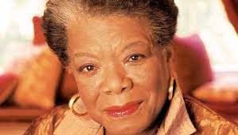
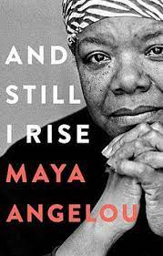
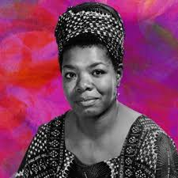
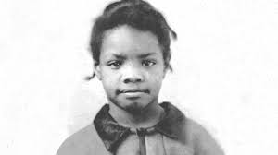
Maya Angelou – 1928-2014
I did then what I knew how to do. Now that I know better, I do better. Do the best you can until you know better and when you know better, DO BETTER!!!!

Slide 20
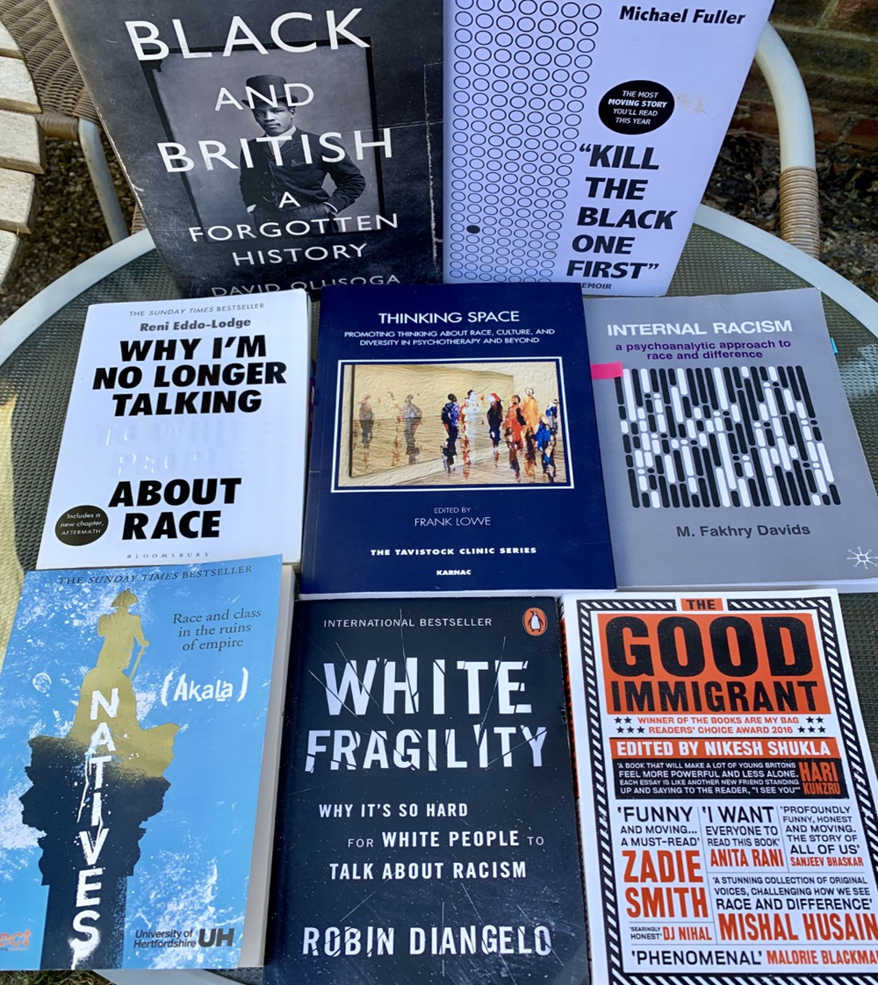
References & Resources
Ahmad, B. (1990) Black Perspectives in Social Work. Venture Press
Barnard H and Turner C (2011) Poverty and Ethnicity: A Review of Evidence. York: Joseph Rowntree Foundation.
Bernard C and Gupta A (2008) ‘Black African Children and the Child Protection System’. British Journal of Social Work 38 (3) 476-492.
Bernard, C. and Thomas, S. (2016) ‘Risk and Safety: A Strengths-based Perspective in Working with Black Families when there are Safeguarding Concerns’ in Williams C and Graham M (eds) ‘Social Work in a Diverse Society’ Transformative Practice with Black and Ethnic Minority Individuals and Communities. Bristol: Policy Press.
Burnham, J. (2012) The importance of being aware of, sensitive to, and competent in. Culture and Reflexivity in Systemic Psychotherapy: Mutual Perspectives, p.139.
Crenshaw, K. (1989). Demarginalizing the intersection of race and sex: A black feminist critique of antidiscrimination doctrine, feminist theory and antiracist politics. u. Chi. Legal f., 139.
Dominelli, L. (2008) Anti-Racist Social Work (3rd Edition) Macmillian.
Eddo-Lodge, R (2018) Why I’m no longer talking to white people about race London: Bloomsbury
Fletcher, J. and Crawford, L. (2019) Developing Cultural Competence. Available at. https://practice-supervisors.rip.org.uk/wp-content/uploads/2019/11/Developing-cultural-competence.pdf
Kendi, I. X. (2019). How to be an antiracist. One world.
Ross, S.D (1994) Locality and Practical Judgement: Clarity and Sacrifice. Fordham University Press New York 1994:143
Singh, G. (2020). White Supremacy to White Allyship. Available at: https://blogs.city.ac.uk/race/resources-hub/inclusive-leadership/white-privilege-and-white-fragility-resources/ Accessed on 26.05.2021
Williams, C. & Bernard, C. (2018) Black History Month: A Provocation and a Timeline. Critical and Radical Social Work. 6 (3): 391-406
Williams, S. (2020) Anti Racist Ally: An Introduction to Action and Activism. HQ

