Slide 1
Delivering a New Module in a Pandemic
Dr John Ramage
ST5 Intensive Care Medicine
Visiting lecturer University of Hertfordshire
j.ramage@herts.ac.uk

Slide 2
Why and Who
Strong team
-Will Broughton
-Alex Ulrich
The rest of the department

Slide 3
Why and who

Slide 4
What

Slide 5
How-The Good

Slide 6
Keeping the good
Case based learning a powerful way to keep students engaged
You can establish level of understanding as they go
They can relate it to existing experiences
Evidence base for improved engagement and improved critical thinking skills (McLean, 2016)

Slide 7
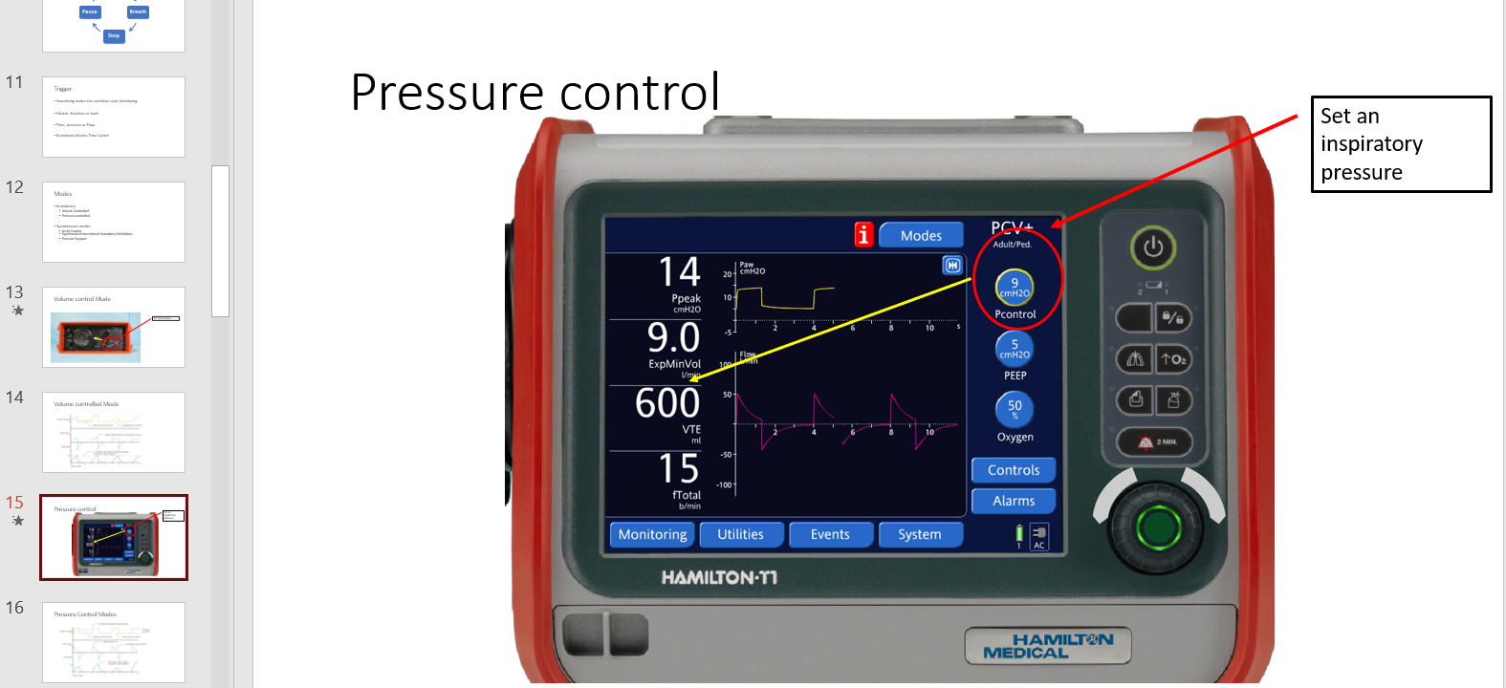
How- The Bad

Slide 8
Changing the Bad
Recognise the difference
Shorter sections
Consider flipped classroom (Reyna, 2020)
More than one lecturer – modelling behaviour (Bradberry, 2016)

Slide 9
How- The Ugly

Slide 10
Changing the ugly
Shorter videos
Pre-recorded
Pre-drawn and narrated
A face narrating

Slide 11
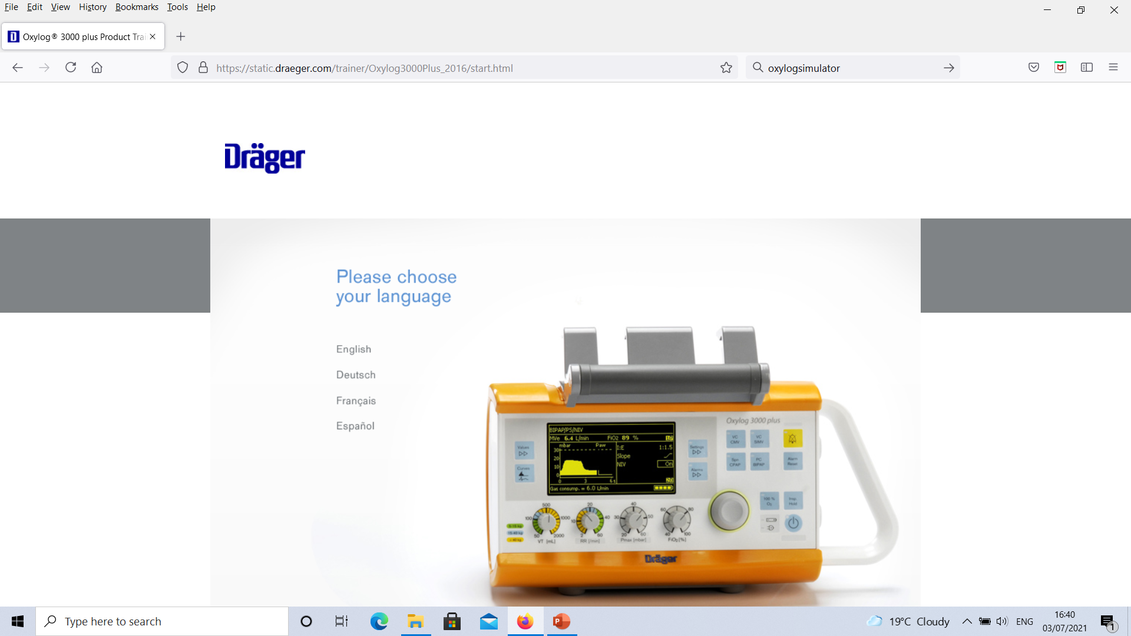
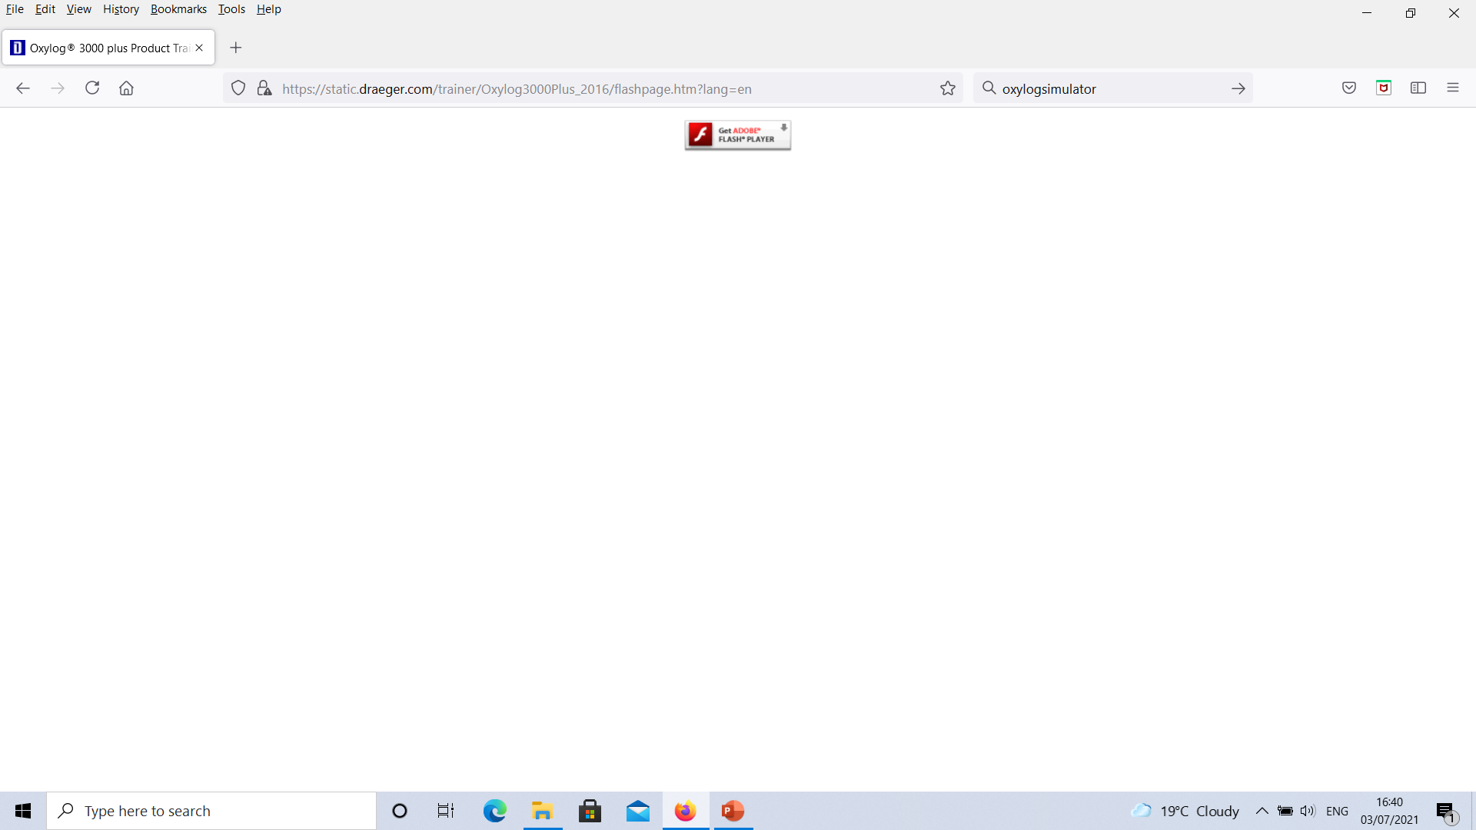
IT
Zoom as a platform
Teams
Adobe flash
A need to learn new techniques

Slide 12
Clinical Placement
Post-poned
COVID – less elective work, complex ventilation
Teaching and learning challenging
Alternative locations?
Placements need to continue

Slide 13
Data

Slide 14
This winter
Covid is still here + RSV/ Flu
An obligation to deliver education
Students keen to progress
Stretched workforce
Other healthcare groups behind

Slide 15
Conclusions
A range of delivery options it can’t be the same lecture on-line
Placements will need to happen
We need data on satisfaction and outcomes
We need to develop expertise in blended learning

Slide 16
“Intelligence plus character – that is the goal of true education”
Dr Martin Luther King Jr.

Slide 17
References
Bradberry N (2016) Attention span during lectures: 8 seconds, 10 minutes, or more?, Advances in Physiological Eductation, 40 (4) 509- 513
College of paramedics (2018) Post Registration career framework 4th Edition, college of paramedics, available from javascript://[Uploaded files/DevelopingtheProfession/June_Final_Paramedic_Career_Framework_4th_edition_2018_-_for_website (1).pdf], accessed on 13/6/21.
Dost s, Hossain A, Shehab M, Abdelwahed A and Al-Nusair L (2020) Perceptions of medical students towards online teaching during the COVID-19 pandemic: a national cross-sectional survey of 2721 UK medical students, BMJ Open, 10, 1-10.
Guo P, Kim J, Rubin R ( 2014) How video production affects student engagement: An empirical study of MOOC videos, Proceedings of the first ACM conference on Learning @ scale conference, available from: https://www.researchgate.net/publication/262393281_How_video_production_affects_student_engagement_An_empirical_study_of_MOOC_videos, accessed on 1/7/21.
Mclean S (2016) Case-Based Learning and its Application in Medical and Health-Care Fields: A Review of Worldwide Literature, Journal of Medical Education and Curricular Development, 3, 39-49.
Reyna J (2020) Twelve Tips for COVID-19 friendly learning designin medical education, MedEdPublsih, https://doi.org/10.15694/mep.2020.000103.1

