Slide 1
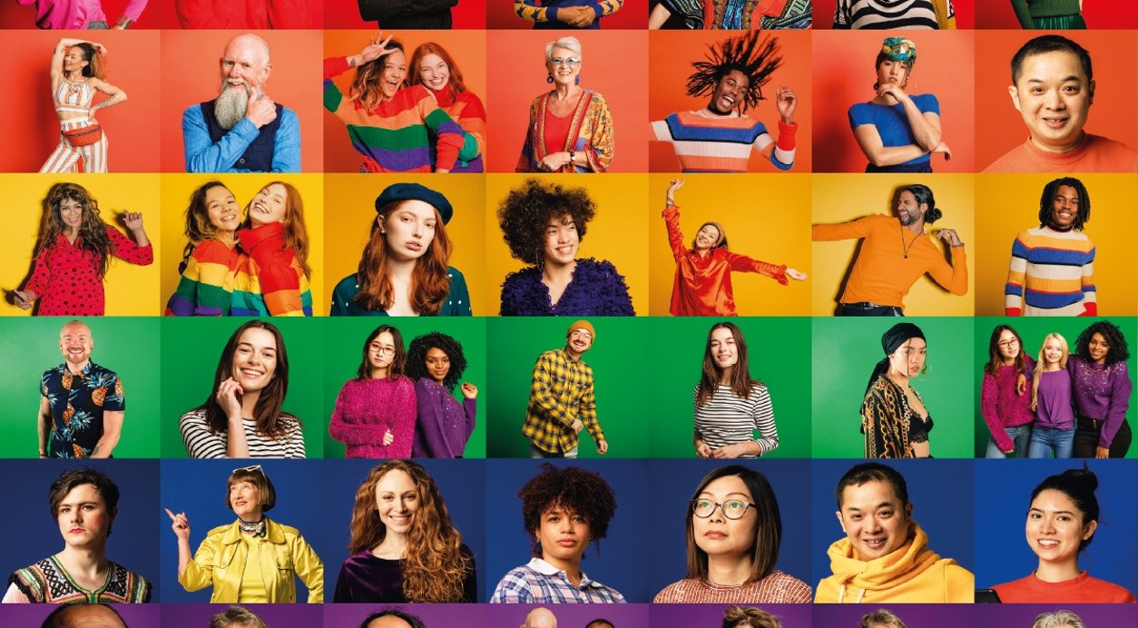
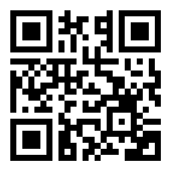
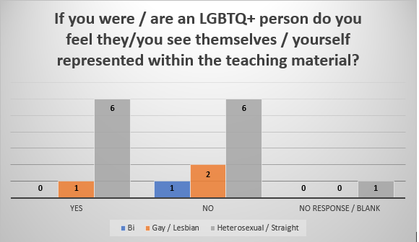
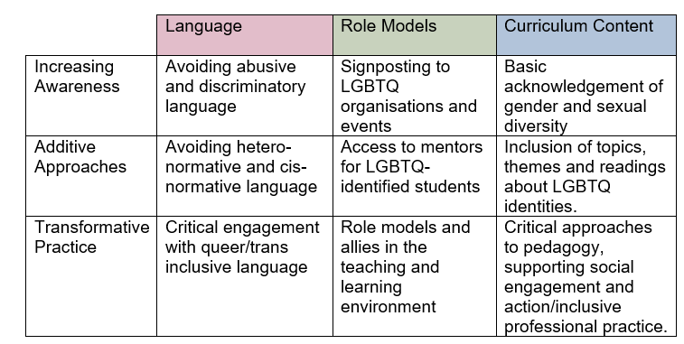
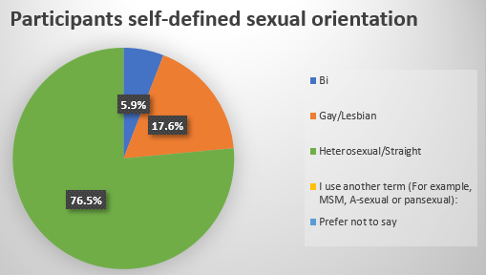
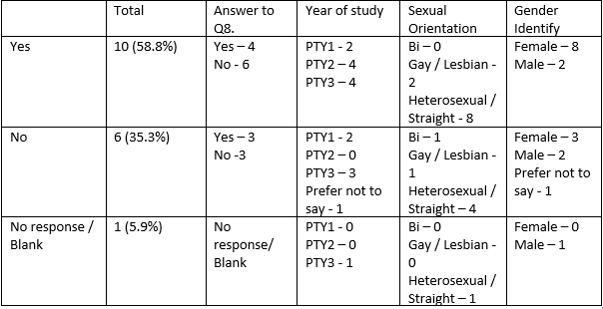
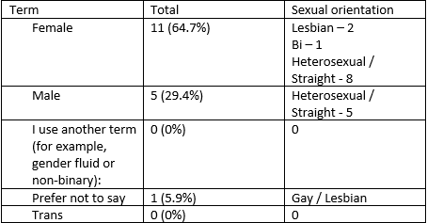
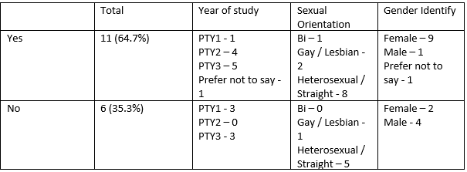
LGBTQ+ inclusion and visibility within the
Undergraduate Physiotherapy Programme
PRESENTED AT:
HSK LEARNING AND TEACHING CONFERENCE
7TH JULY 2021.
Matthew Guilliatt
Senior Lecturer in Physiotherapy
Introduction
The inclusive curriculum framework has been a key focus recently addressing the awarding gap for Black Asian and Minority Ethnic (BAME) students (McDuff et al., 2020) however, the effects on the Lesbian, Gay, Bisexual, Transgender, Queer + (LGBTQ+) community has not been as widely investigated (Page, 2016)
.
Results
For full results to all 13 questions please use the QR code.
Response rate = 17 students (8% of the cohort).
Question 1 – Which best describes your sexual orientation.
Question 3 – Which best describes your gender identity.
Question 7 – Within your physiotherapy teaching to date have there been any teaching material that has included the LGBTQ+ community
Question 8 –
Question 9 – Do you think it is important to feel that you are represented / see yourself within the teaching material?
Question 13 – Students observations / suggestions on LGBTQ+ inclusion and visibility within the programme?
Figure 1. The Ward-Gale Model for LGBTQ-Inclusivity in Higher Education (University of Birmingham, 2017).
Q8 matched with results for Q1.
9/17 (52.9%) reported No.
4/17 (23.5%) students identified as LGBTQ+
Purpose
The key aims were to establish if there was representation of the LGBTQ+ community within the undergraduate physiotherapy programme and whether students feel representation within the teaching material was important.
Conclusions & implications
Inclusive curriculum applies to all students irrespective of religion, gender, race, disability and socioeconomic backgrounds (McDuff et al., 2020). Embedding The Ward-Gate model are stratagies to increase representation of LGBTQ+ community within the programme (University of Birmingham, 2017) which reflected the views of participants.
This has been matched against answers for Q1.
Methods
Participants: Purposeful sample of students currently enrolled on the Bsc (Hons) Physiotherapy programme (n=209) at the University of Hertfordshire selcted.
Design: Self-reported anonymous questionnaire method utilised from the 15th – 29th March 2021, Using Microsoft forms as the platform for the survey which consisted of a maximum of 13 questions. Students where invited to participate via annoncement on canvas with one follow up reminder sent after 1 week. The results where then contextualised against secondary research.
Results to Q9 have been cross matched with answers for Q1, Q2, Q5 and Q8
Acknowledgements
Ethics approval: Granted from the University of Hertfordshire Health, Science, Engineering and Technology Ethics Committee with Delegated Authority (Protocol Number aHSK/SF/UH/04488(1))
One students view of things the programme can do: ‘1) improve the awareness through sessions on respect, discrimination and inclusion. 2) … guest speakers from the LGBTQ community and physios to talk about their experiences … and how they were treated as students or clinicians. this will help with awareness 3) … include more examples in the case scenarios, exam questions using LGBTQ patients.’
Reference
Page, M. L. (2016). LGBTQ inclusion as an outcome of critical pedagogy. The International Journal of Critical Pedagogy, 7(1), 115-142.
Q7 results cross matched with answers for Q1, Q2 and Q5
Author contact details
m.guilliatt2@Herts.ac.uk

