Slide 1
A proposed HSK Multimedia Assessment Framework for effective use of multimedia assignments in a higher education setting
A Successful Student with positive learning experience
Richard Matovu & Dr Anthony Herbland
Notes:
Welcome to our presentation: A proposed HSK Multimedia Assessment Framework for effective use of multimedia assignments in a higher education setting
Question for the audience: What kind learner experience would you want to give your students if you ever decided to run something called a multimedia assignment

Slide 2
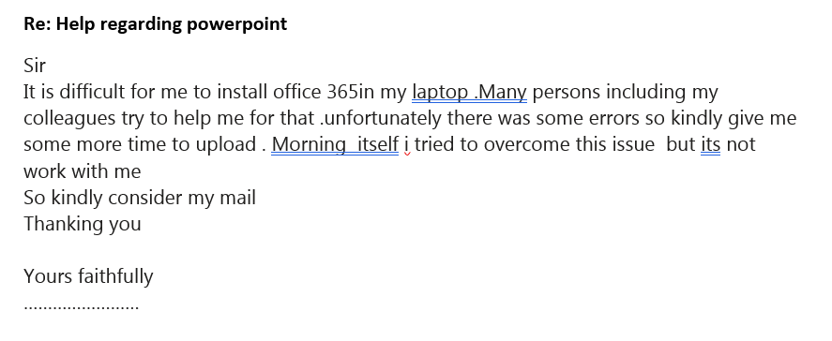
What learning experience are these students having?
Notes:
Use this slide to very brief story / that matters to the audience (1 min)

Slide 3
Introduction
Background
The use of multimedia assessments in many modules across the School has emerged since semester A 2019 as a new method of assessment rather than using the conventional written essay assignments.
Recent examples include the use of narrated PowerPoint presentations, recorded practical skills videos, audio podcasts, narrated digital posters, digital stories using PowToon animations, etc.
Unfortunately, this has also caused a lot of unforeseen problems and frustrations for both HSK students and teaching staff undertaking these multimedia assessments.
This empirical development has led towards the creation of the HSK multimedia assessment framework. This presentation will share with you this framework.
The framework describes some practical key attributes you need to consider for an effective use of multimedia assignments as an assessment tool.
We shall also give some examples how the HSK Educational Technology team can support HSK staff in transforming their assessment approach towards multimedia assignments.
Notes:
Empirical approach – starting from scratch

Slide 4
Key words
What is multimedia?
Multimedia is described as the combination of more than one type of media to create a finished product. The types of media could include images, illustrations, text, video, audio and animations (Mayer, 2009).
An example of a multimedia product would be a narrated presentation video, made up of written text, images, illustrations and the student’s voice narration.
Image
Text
Video
Audio
Combination of different media makes a multimedia product
Notes:
This is about the Media

Slide 5
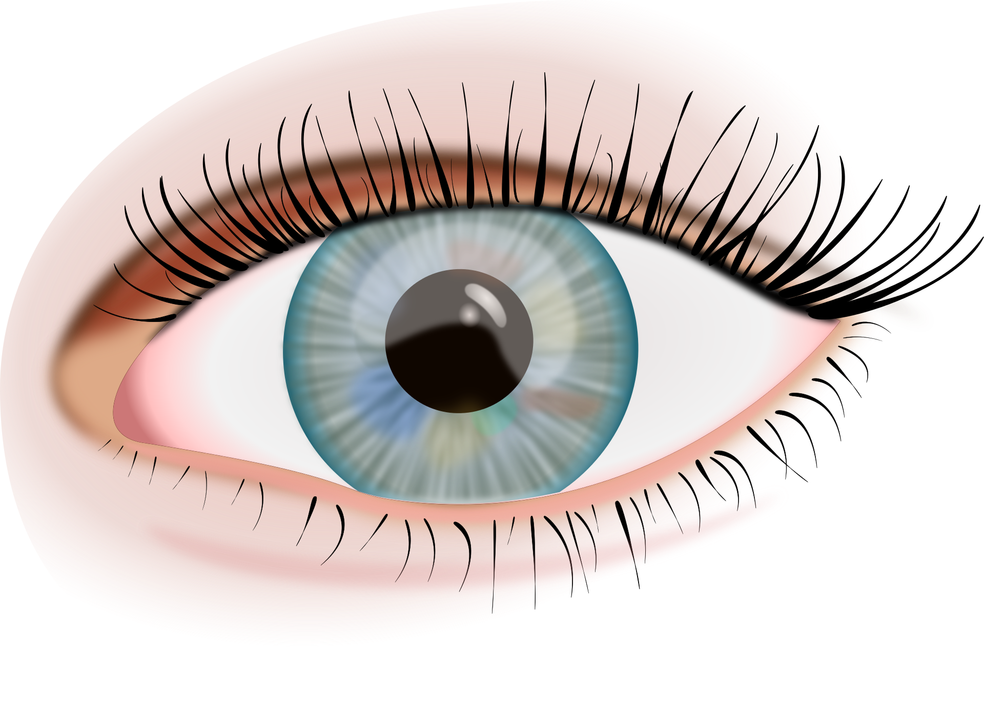
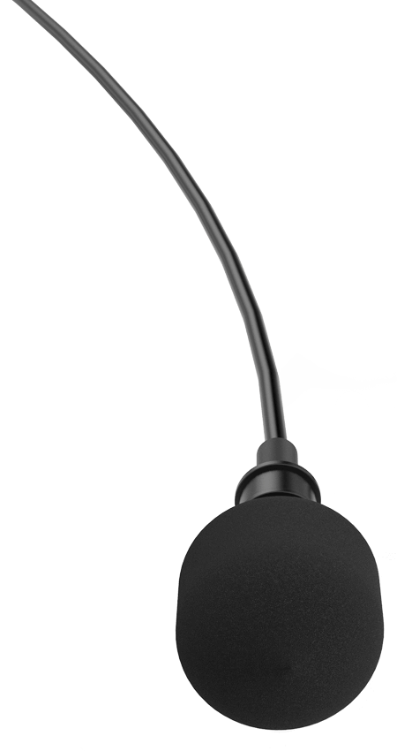
Key words
What is multimodal learning?
Multimodal learning is about using different modes of learning / learning styles to teach a concept and enhance a learner’s learning experience. This could involve teaching a concept using a combination of visual, aural, kinaesthetic and writing or reading learning styles / modes of learning (Tham, 2015).
As you know we all do not learn the same way, the idea of being able to apply the different modes of learning / learning styles and be able to provide the different ways of engaging the learners is the underlying principle of multimodal learning.
Visual Learner
Auditory (Aural) Learner
Reading / Writing Learner
Kinaesthetic Learner
Applying the different styles of learning / Modes of learning = Multimodal learning
Notes:
What is Multimodal learning?
Multimodal learning is about using different modes of learning styles to teach a concept and hence a learner’s learning experience. This could involve teaching a concept using a combination of aural, visual, kinaesthetic and writing or reading learning styles modes.

Slide 6
Key words
What is multimodal assessment?
Multimodal assessment is an assessment type that uses a mixture of different learning styles / modes of learning.
Using a multimedia assignment instead of the usual written essay or presentation type of assessments is one way of embracing the merits of multimodal learning and assessment.
It is a very good way of increasing students’ engagement with what they are learning as it gives them the opportunity to mix their preferred learning styles / modes of learning when working on their assignment (Lauer, 2009; Pirhonen & Rasi, 2017).
Visual Learner
Auditory (Aural) Learner
Reading / Writing Learner
Kinaesthetic Learner
Applying the different styles of learning / Modes of learning = Multimodal learning / Multimodal assessment
Notes:
Since people generally have a preference of how they best learn, using a method of learning that caters for the different learning styles / modes of learning is a merit for adopting multimodal assessment

Slide 7
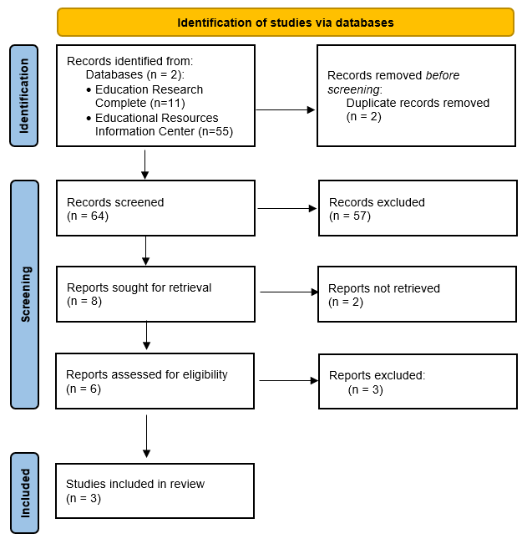
PRISMA 2020 flow diagram
Literature: Search Strategy
Keywords:
(title: "model" OR "framework") AND (title: "Learner-Generated Digital Media" OR "multimedia " OR "multimodal") AND "assessment"
Inclusion criteria: higher education, last 5 years, peer reviewed, English
Blum, M., & Barger, A. (2018). The CASPA Model: An Emerging Approach to Integrating Multimodal Assignments. Journal of Educational Multimedia & Hypermedia, 27(3), 309-321.
Reyna, J., & Meier, P. (2018). A Practical Model for Implementing Digital Media Assessments in Tertiary Science Education. American Journal of Educational Research, 6(1), 27-31. http://pubs.sciepub.com/
Ross, J., Curwood, J. S., & Bell, A. (2020). A multimodal assessment framework for higher education. E-Learning and Digital Media, 17(4), 290–306. https://doi.org/10.1177/2042753020927201
Notes:
https://www.studynet1.herts.ac.uk/ptl/common/LIS.nsf/lis/EducationDatabases

Slide 8
Pedagogy- Why use Multimedia assignments
Multimedia assignments can:
Provide opportunity for students to develop visual presentation skills in conjunction with writing and promote the sharing of knowledge (Riordan et al., 2020).
Promote active learning (Coulson & Frawley, 2017; Pirhonen & Rasi, 2016).
Allow students to demonstrate their assessed skills using new and engaging methods of working (Cox et al., 2010, Ledonne, 2014).
Provide opportunity to develop graduate attributes such as planning skills, time manage­ment, communication skills (Frawley et al., 2015; Morel & Keahey, 2016).
Test students’ ability to relate with information in a different way than they would with just written assignments. This boosts the way they deal with the given content hence providing the opportunity to extend the students’ learning experience (Ledonne, 2014).
Boost teamwork which produces a setting favourable to reflection and deep learning (Cox et al., Pirhonen & Rasi, 2016).
Notes:
According to the recent literature, multimedia assignments can provide opportunity for students to develop visual presentation skills (Riordan et al., 2020), to deepen their active learning (Coulson & Frawley, 2017; Pirhonen & Rasi, 2016), and to demonstrate their assessed skills using new and engaging methods of working (Ledonne, 2014).
Development of graduate attributes for example, planning skills, time manage­ment, communication are further benefits of using multimedia assignments (Frawley et al. 2015; Morel and Keahey 2016).
The above views support the assertions made by Ledonne (2014) that multimedia assignments can test students’ ability to relate with information in a different way than they would with written assignments, which boosts a form of dealings with the given content that may extend the students’ learning experience.

Slide 9
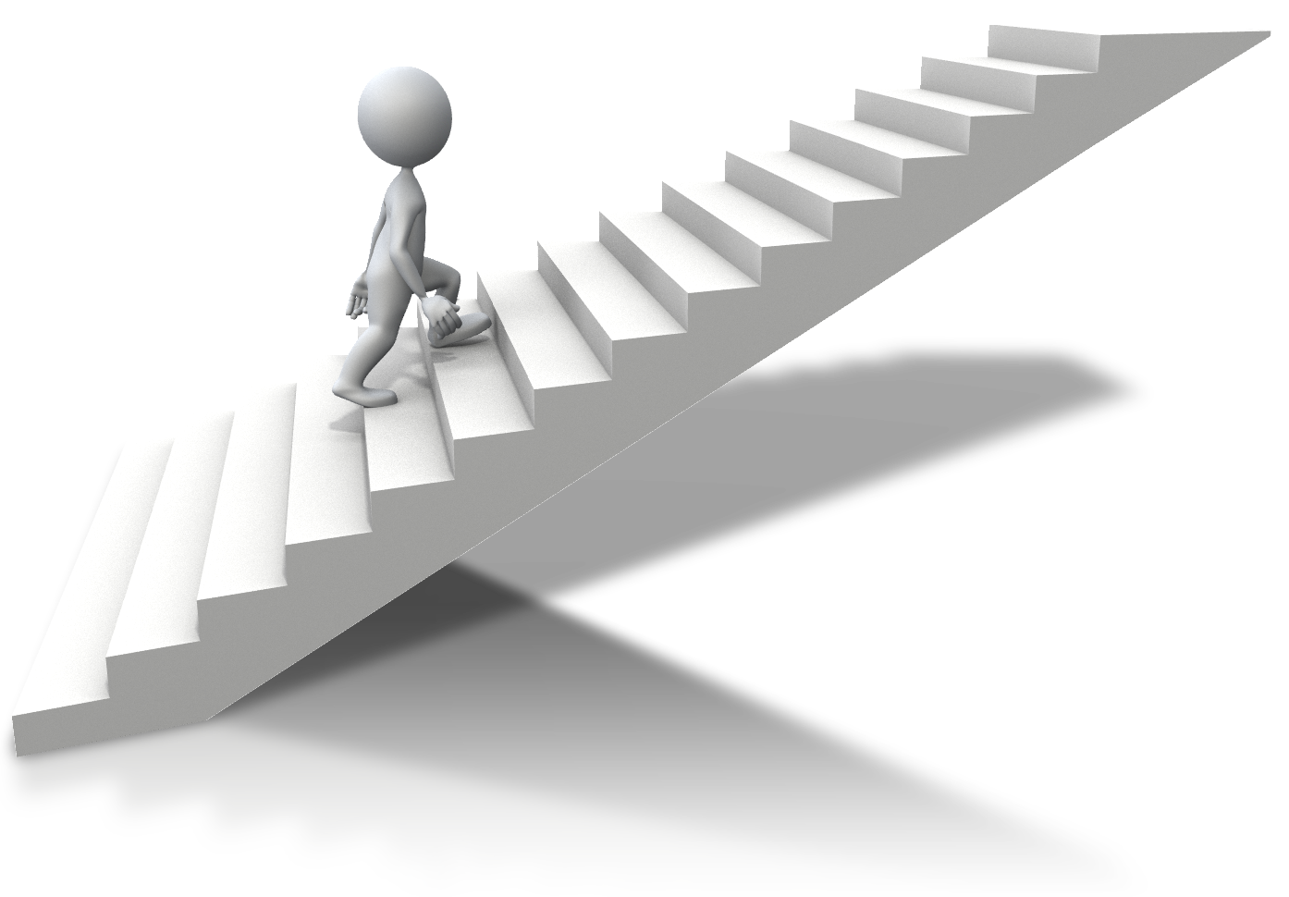
Proposed HSK Multimedia Assessment Framework
Pedagogy
Framework diagram
Why do you need to use a Multimedia assignment?
Evaluation
Marking criteria
Embed Scaffolding
Reflection
Group Contribution (Optional)
A Successful Student with positive learning experience
Feedback for learning
Student training
Markers‘ meeting
Hosting and submission
Notes:
The framework takes into account of the following attributes:
Pedagogy, Marking criteria, Group contribution (Optional), Student training, Hosting and submission, Markers‘ meeting, Feedback for learning, Reflection, Evaluation, Embed & embrace scaffolding.
10 attributes
Reyna & Meier (2018) devised a theoretical, practical, framework called the digital media implementation framework aimed at guiding the implementation of digital presentations as assessment tools in tertiary science learning. Similarly Blum & Barger (2018) also devised a practical model called, the consume, analyze, scaffold, produce, assess (CASPA). The CASPA model was aimed at designing and implementing multimedia projects.

Slide 10
Proposed HSK Multimedia Assessment Framework
How the framework could be used
See the framework document on how to use this framework

Slide 11
Way forward / Future Plan
Promote the HSK Multimedia Assessment Framework in the School
Continue developing and updating resources to support the delivery of multimodal assignments across the school.
Examples of identified areas that need training resources
Using Powerpoint for graphics and multimedia tasks – especially for Adult learners and international students
Basic video and Audio editing skills e.g., trimming off unwanted parts
File sharing and working with OneDrive shared documents
While working on the proposed framework, some key areas that need further work have been identified:
Supporting students with multimedia planning and presentation skills
Updating Marking criteria used on many multimedia assessments used across the school
Promote and encourage the need to have Marker’s meetings before assessing summative multimedia assessments. This will improve consistence and fairness in the marked work
Notes:
Examples of identified areas that need training resources
Using Powerpoint for graphics and multimedia tasks – especially for Adult learners and international students
Basic video and Audio editing skills e.g. trimming off unwanted parts
File sharing and working with OneDrive shared documents

Slide 12
Available HSK EdTech support
HSK EdTech team is always happy to help / support
you and your team in planning and in effectively delivering multimedia assessment
your students by providing relevant training and guidance.
Please do get in touch before the module starts rather than when students are already working on their summative assignment.

Slide 13
References
Blum, M., & Barger, A. (2018). The CASPA Model: An Emerging Approach to Integrating Multimodal Assignments. Journal of Educational Multimedia & Hypermedia, 27(3), 309-321. Retrieved June 10, 2021 from https://www.learntechlib.org/primary/p/178532/.
Coulson, S. & Frawley, J. K. (2017). Student generated multimedia for supporting learning in an undergraduate physiotherapy course. In H. Partridge, K. Davis & J. Thomas (Eds.), Me, Us, IT! Proceedings ASCILITE2017: 34th International Conference on Innovation, Practice and Research in the Use of Educational Technologies in Tertiary Education. (pp. 235–244). University of Southern Queensland
Cox, A. M., Vasconcelos, A. C., & Holdridge, P. (2010). Diversifying assessment through multimedia creation in a non-technical module: Reflections on the MAIK project. Assessment and Evaluation in Higher Education, 35(7), 831-846. https://doi.org/10.1080/02602930903125249
Earnshaw, R. (2017). State of the art in digital media and applications. Springer, Bradford, UK. https://doi.org/10.1007/978-3-319-61409-0
Lauer, C. (2009). Contending with terms: “Multimodal” and “Multimedia” in the academic and public spheres. Computers and Composition, 26(4), 225-239. https://doi.org/10.1016/j.compcom.2009.09.001
Ledonne, D. (2014). Multimedia assignments: not just for film majors anymore. Chronicle of Higher Education, 60(32). https://www.chronicle.com/article/Multimedia-Assignments-Not/145939

Slide 14
References
Mayer, R. E. (2009). Multimedia learning (2nd ed.). Cambridge University Press. https://doi.org/DOI:10.1017/CBO9780511811678
Martin, J. M. & Zahrndt, J. (2017). Media and digital literacy: a framework for instructional strategy. In M.G. Strawser (Ed.), New media and digital pedagogy: enhancing the twenty-first-century classroom. (pp 33–54). Lexington Books, London.
Pirhonen, J., & Rasi, P. (2017). Student-generated instructional videos facilitate learning through positive emotions. Journal of Biological Education, 51(3), 215-227. https://doi.org/10.1080/00219266.2016.1200647
Reyna, J., & Meier, P. (2018). Using the learner-generated digital media (LGDM) framework in tertiary science education: a pilot study. Education Sciences, 8(3), 106. https://www.mdpi.com/2227-7102/8/3/106
Reyna, J., & Meier, P. (2018). A Practical Model for Implementing Digital Media Assessments in Tertiary Science Education. American Journal of Educational Research, 6(1), 27-31.
Riordan, M. A., Abo-Zebiba, Z., & Marsh, J. (2020). A comparison of multimedia and traditional paper assignments in an introductory psychology course. Teaching of Psychology. https://doi.org/10.1177/0098628320954192
Ross, J., Curwood, J. S., & Bell, A. (2020). A multimodal assessment framework for higher education. E-Learning and Digital Media, 17(4), 290–306. https://doi.org/10.1177/2042753020927201
Tham, J. (2015, May 19). Multimedia vs. multimodal: A matter of terms. Retrieved June 30, from https://jasontham.com/2015/05/19/multimedia-vs-multimodal-a-matter-of-terms/

Slide 15
Thank You

