Slide 1
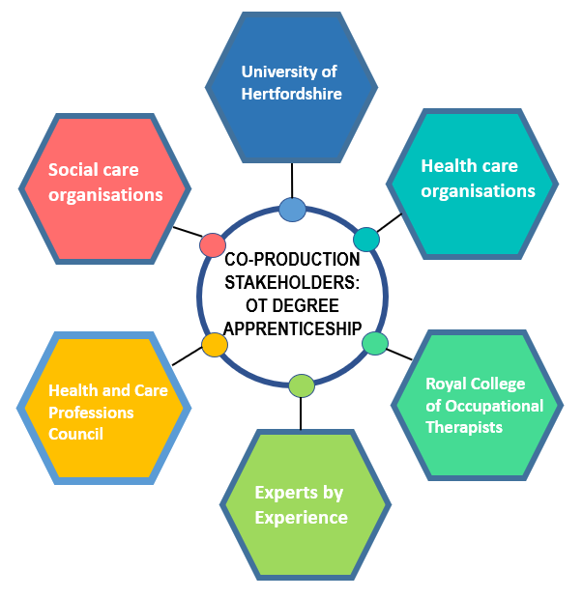
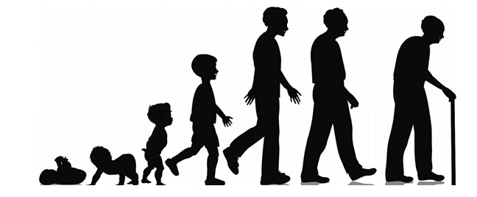
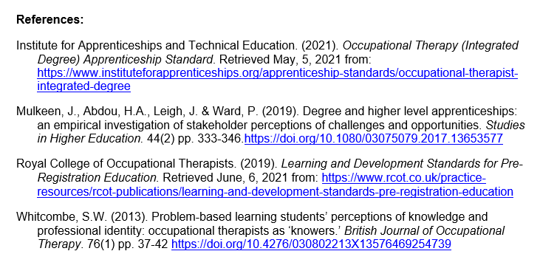
A new vision for the Occupational Therapy workforce: co-production and validation of a degree apprenticeship
Successful validation
Claire Lancaster & Lindsay Truran
c.lancaster2@herts.ac.uk
l.truran@herts.ac.uk
Impact
Implementation
Curriculum focused on enquiry based learning (Whitcombe, 2013)
Validation event – Feb 2020
Condition: Occupation as the central focus across the lifespan (Royal College of Occupational Therapists (2019)
Previous modules focused on physical health and mental health separately
Enables case scenarios to reflect practice incorporating physical and psychosocial occupational needs
Re-design of curriculum and consultation with employers
Support from professional lead consultant
(Mulkeen et al, 2019)
Level 4 & 5 – introduction of lifespan focused modules - Children and Young People, Adults of Working Age, Older Adults (15 credit)
Level 4 –Occupational Lifespan Perspectives (15 credit)
Level 5 – Groups and Communities (15 credit)
Level 6 – introduction of a 2 week leadership shadowing opportunity
”A good challenge and learning experience. An effective way to cover a lot of ground deeply.” (Apprentice feedback)

