Slide 2
A service user, carer and student perspective of Co-Production in Leadership and Management

Slide 3
Louise Cobb, Flic Horner, Katie Varley, Jessica Towne Tony Storton and Jan leeks
Your presenters are:

Slide 4
Why is Co-production vital to the curriculum
PPI often interpreted as consultation - NICE guidelines, Healthwatch
NMC standards 2018 - curricula are co-produced with stakeholders who have experience relevant to the programme.
Being taught by, rather than taught about, will equip students to be more effective _{(terry 2012)}
Notes:
PPI interpreted as consultation, however DOH is clear that along with collaboration on planning implementation and evaluation of health and social care services – it involves the education of professionals working in those services. Tokenism is still evident in HE, serving to reinforce hierarchal structures and appose the ethos of co-production

Slide 5
Inclusive participation
Invited to module team
Planning and co-writing case studies
Co-design of supervision template
Formulation of supervision groups
Weekly Debriefing
Paid for all the time worked
Notes:
The team decided to move around each group to promote diversity within the facilitation and sharing of expertise.

Slide 6
Summative Assessment
Supervision groups allocated
Students delivered x2 10 minute presentations over 5 weeks
Facilitators supported each group
Facilitated discussion lead by supervisors on leadership dilemma presented
X4 Supervision templates submitted
Completion of x1 case study 1500 words
Notes:
This delivery would not have been possible face to face due to restrictions with classrooms, online meant that speaker could join from all over the country, in fact Andy was at the nightingale hospital during two groups – hidden in a corner

Slide 7
Louise Cobb – Service User and Carer Perspective
Student, Service User and Carers’ Perspective of involvement in a co-produced module

Slide 8
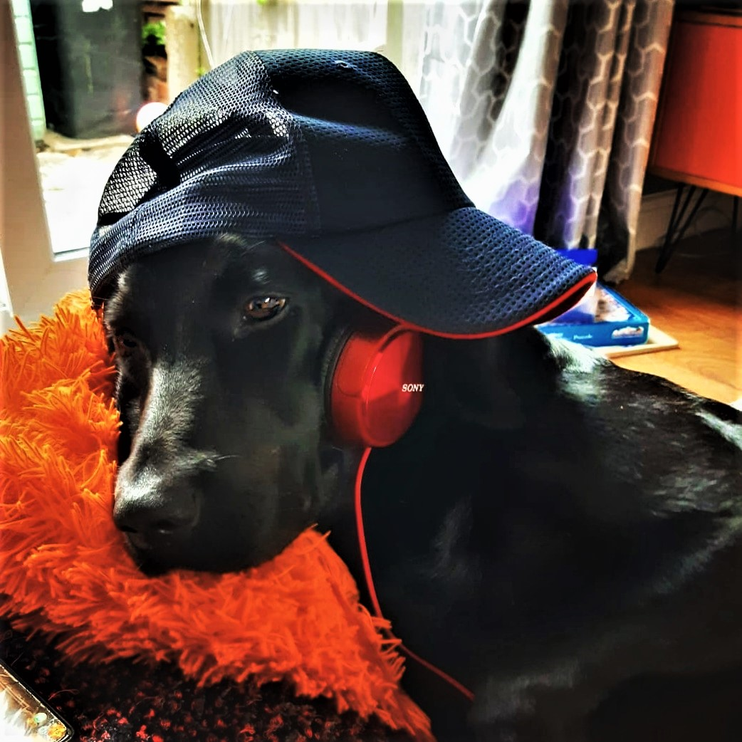

Slide 9
4Pi as a framework for the involvement of service users and carers –
in care, communities, strategy and education.
PRINCIPLES
Meaningful and inclusive involvement depends on a commitment to shared principles and values. This includes valuing the contribution of service users and carers equally to those of professionals.
PURPOSE
The purpose of involvement should be clear and clearly communicated to everyone involved in the activity as well as the wider organisation.
Developed by people with lived experience as part of the National Involvement Partnership (NIP) project, NSUN.org.uk, 2013

Slide 11
PRESENCE
The people who are involved should reflect the nature and purpose of the involvement.
PROCESS
The process of involvement needs to be carefully planned in terms of issues like recruitment, communications, being offered appropriate support and training and payment, so that service users and carers, including those from marginalised communities, can get involved easily and make the best possible contribution.
IMPACT
For involvement to be meaningful, it needs to make a difference to the lives or the experiences of service users and carers. This means be clear about the purpose of involvement, the individuals and groups who will be present and their role in the process. When a particular piece of work is complete feed-back on what has been achieved to those involved.
Developed by people with lived experience as part of the National Involvement Partnership (NIP) project, NSUN.org.uk

Slide 13
Student Experience of Co-produced Learning Modules

Slide 14
Perspective Is All Important
Having a rounded view of the problem is key to deeper understanding.
We experienced supervision from service user, carer, academic and management angles.
This enhanced and deepened our learning.

Slide 15
All angles are necessary to synthesize a full understanding of the whole.

Slide 16
Was there a communication bias towards experts by experience compared to experts by profession?

Slide 17
Students may have been more sensitive when talking to experts by experience
This intention was polite in nature, but may have resulted in performative reflections. Students may have avoided talking about subjects they feared may offend the service users.

Slide 18
This could be seen as a positive, as students should be learning to be service user focused and compassionate. However, using different communication styles with experts by experience vs professionals serves to reinforce stereotypes of service users as less academic or more sensitive than none-service users

Slide 19
It is interesting to consider if the experience would have been different if students had not been aware which speakers were experts by experience and which were experts by profession. However, the confrontation of stereotypes was a unique factor of the module...

Slide 20
Challenging Stereotypes

Slide 21
Why may some students develop stereotypes?
Repeated patterns, presentations and behaviors observed in practice
Lack of understanding
Misinformation
Personal experiences.

Slide 22
How have stereotypes been challenged through this module?
There is more to a person than the clinical label given to them
By having a service user who is contributing to a teaching module we allow students to learn some crucial things
We can learn from the people that we care for
Service users can be academic and successful

Slide 23
Feedback from students
Theory and reflection combined
Ensure consistency in the quality of presentations
Introduce weekly articles
Divide across two semesters 1 hour theory 2 hours reflection
Clear guidance on presentations. ?Grading by peers
Set time for article discussion clear expectations or pre reading
“Excellently planned and really engaging. I loved the use of having service users and the leadership and management.”
“The mode of delivery was fantastic and flexible.”
“The breadth of experience of the guest speakers really helped me to learn.”

Slide 24
Thank you

