Slide 1
Understanding the attainment gap in diagnostic radiography - an exploration of student experience of learning, engagement and support
Project team – dr Aarthi Ramlaul, dr olan lawal, mrs Louise Hadley, Ms Kaschta Jan (student), ms layla shah (student) and ms Jessica rached Byron (STUDENT)

Slide 2

Background and purpose
#Closingthegap report (2019)
Attainment gap in diagnostic radiography in 2019-20 = 40.9% (Tableau)
  Black, Asian and Minority Ethnic students (BAME) and non-BAME students
  3 year full-time programme
    Eligibility to register as a diagnostic radiographer with the HCPC
  72% BAME : 28% non-BAME students (Tableau)
  Low levels of diversity and representation has been associated with a high attainment gap (Rollock, 2019)
Purpose of project
  Universities must partner meaningfully with students to robustly address this gap (Amos, 2019)
Outcome of project

Slide 3

Methods
Qualitative study design
3 parts
  Part 1 – Questionnaire
  Part 2 – Focus groups
  Part 3 – Individual, semi-structured, face-face to interviews
Focus groups and interviews will be conducted by student researchers
Ethics approval from the Health, Science, Engineering and Technology ECDA at UH

Slide 4
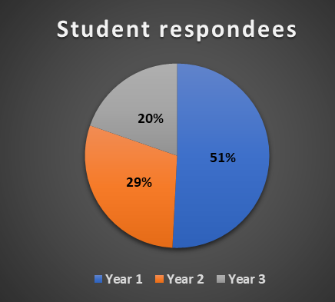
Part 1 – questionnaire
Participants
  Diagnostic radiography students
  Programme cohort of 377 students
Online questionnaire via JISC survey platform
Response rate 16%
  Year 1 (n=31)
  Year 2 (n=18)
  Year 3 (n=12)
Open-ended questions
This presentation
  Perceived challenges
  Early thoughts on the attainment gap
  Perceptions of a ‘good’ degree

Slide 5
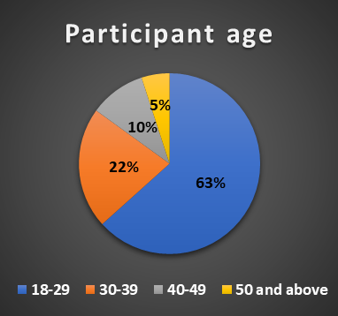
demographics -AGe
18-29 (n=38)
30-39 (n=13)
40-49 (n=6)
50 and above = (n=3)

Slide 6
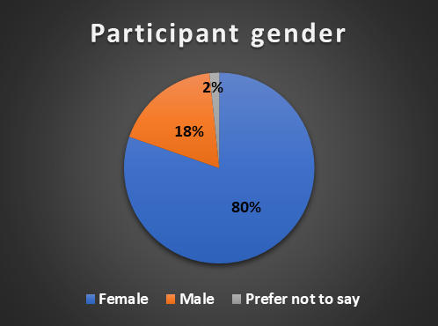
demographics - gender
Female (n=49)
Male (n=11)
Prefer not to say (n=1)

Slide 7
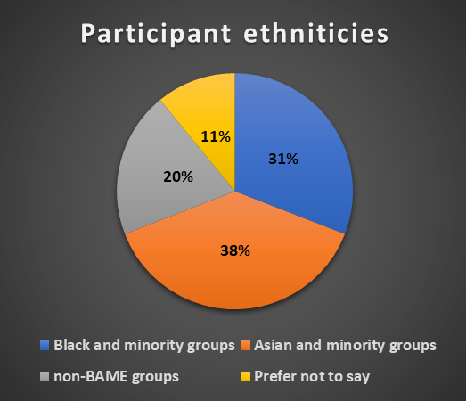
demographics -ethnicities
Asian and minority groups (n=21)
Black and minority groups (n=17)
Non-BAME groups (n=11)
Prefer not to say (n=6)

Slide 8
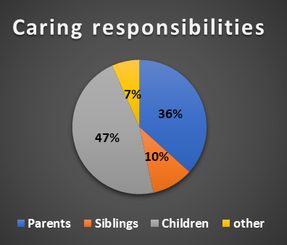
demographics –caring responsibilities
49% (n=30)

Slide 9
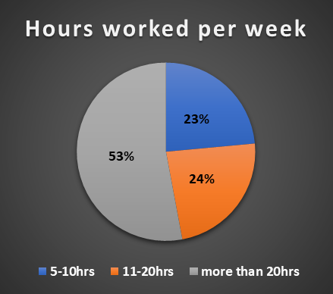
demographics – part-time employment responsibilities
31% (n=19) are employed part-time

Slide 10
Findings - What do you consider to be the biggest challenge in studying for a radiography degree at university and achieving good grades?
….for me the biggest challenge was adapting to an online learning style…
There is a lot of content to get through in a short period…
…not enough practical time and less placement…
Time management while juggling home and child responsibilities…
Balancing my part time job and studies.
…have to travel very far for placement…
…essay writing was hard…
…exam and marking was very harsh as a first year…

Slide 11
Findings - Why do you think this attainment gap exists?
Language and communication
Lifestyle or socio cultural differences
Support/ experience at university
Having other responsibilities
Socio economic/ Environmental
Systemic racism
Absence of role models/ sense of belonging

Slide 12
Language and communication
I believe the course is hard in general, but it's even more harder for students that English is not their first language. (Asian and minority group student)
Technical language used on the course … (Asian and minority group student)
One of the reason is "English" not being the first language for the ethnic minority group due to which they cannot express their ideas as clearly although they work harder than non-ethnic group. (Asian and minority group student)
I think a large number of students have English as their second or third language and their academic writing skills need more support (student of unknown ethnicity)

Slide 13
Support at university
…BAME need more supports (Black and minority group student)
…The lack of language support for these minority groups is affecting them the most. I think the university is not giving them enough resources to help them achieve a good grade and the university's expectation is the same as a non-ethnic minority which is not fair (student of unknown ethnicity)

Slide 14
experience at university
…I have felt as if I could not reach out to the lecturers for helpful advice. Its partly to do with the method of education we have received as some of the lecturers come across as intimidating, cold or more focused on the technology…. (Black and minority group student)
I do think the online teaching does not help as, tutors can not interact and communicate properly with their students (non-BAME group student)
..as a black student myself we are not valued and this can be visible through the interaction lecturers make with their students. Lecturers have favourite students and biased judgment on marks individual students should receive. (Black and minority group student)
This is because assignments and dissertations are not marked fairly. (Black and minority group student )
…the same tutor is given to the same student for multiple assignments (Asian and minority group student)

Slide 15
Lifestyle / socio cultural differences
With BAME students we have more responsibilities. As well as getting our education we're at the forefront of looking after our parents and siblings. There's nothing wrong with that, in fact it is our duty, however the education system fails to acknowledge these cultural differences and disregards this completely which leaves very capable students receiving lower grades when in fact it should be considered. (Asian and minority group student)
Culture difference, usually ethnic minority student might have more familial and financial responsibilities due to the correlation with lower incomes that distracts from studies many ethnic minority students are the first in their family to attend university and don't have the same support / help / guidance system as others (student of unknown ethnicity)
I don’t think it’s a cultural thing I just think it depends on how motivated the student is (non-BAME group student)

Slide 16
Socio economic
Most students from an ethnic minority background have to work to financial support themselves (Black and minority group student)
..Students from ethnic backgrounds may have to juggle sometimes more than our white peers in the degree such as having a job to help support our degree and not having more time aside to revise or maybe have more responsibility to support a family or children compared to our white peers (Black and minority group student)

Slide 17
Environmental
I think geographical location and demographics also plays a major role. My secondary school was rated ‘needs improvement’ by OFSTED, my postcode is rated very poorly on postcode rating websites, and majority of students had no aspirations for further study in my high school... (Asian and minority group student)
… we are always automatically placed into estates which tends to be in areas that are considered poor and have a high crime, not having teachers from ethnic minorities also plays a role ….(Black and minority group student)
During lockdown the university did not take into account how COVID could effect the student from ethnic minorities, there students who shared room with 3 or 4 siblings. They had nowhere to study. Some students did not have access to internet or laptops but help offered was very limited. I know people who failed exams because they had nowhere to study and when they applied for SACs it was declined because living in 2 bedroom house with 5 other kids wasn’t good enough reason. (Black and minority group student)

Slide 18
Systemic racism
Us black people have always been underprivileged, this stems from systemic and environmental racism. (Black and minority group student)
..Subtle racism can be the mere difference in the time and effort that lecturers put into monitoring the progress and efforts of non-ethnic students compared to those of ethnic students. As the data is from 2019 - 2020, I believe that it will drastically be improved for 2020 - 2021 as the Black Lives Matter movement and other movements concerning ethnic minorities has ensured that we are heard and there is fair treatment. Thus far as a 1st-year ethnic student, I have not felt out of place or treated unfairly and have been encouraged by lecturers and my tutor to work hard which shows that there has been an improvement if this was potentially not the case before, and this will be projected into the new results. (Black and minority group student)
As a person from an ethnic group. I feel like sometimes we are looked at differently and are treated different. We are hard working people but I personally feel like I have to work 10x harder just to feel appreciated. (ethnic group not stated)

Slide 19
Absence of role models/sense of belonging
I think that as a BAME member myself, I’ve seen many BAME friends that don’t have any role models to look up to in their own households. I myself am the first female in my entire extended family to ever go to university for further education. And self motivation may be more difficult for some, more than others in such an environment. (Asian and minority group student)
…all lecturers are white except for one black and one Asian. This is a very deep and important topic to look into. (Black and minority group student)
There is a lack of lecturers from the BAME group which results in a lack of representation or depleting confidence in students among this group. (Black and minority group student)
Ethnic minority or maybe international students like me, I feel that we face different challenges compared to the non-ethnic group. I think the lack of support is one and with year 1 being conducted online, it has been difficult to make any friends. (Asian and minority group student)

Slide 20
Findings - How important is getting a good degree to you?

Slide 21
Findings - importance of getting a good degree
To me it's not always about getting a good degree as being smart is not a measurement when working in the field. It's more to do of how good you are practically when working
I would like to achieve a 2.1 or 1st as I think this can help with employment as there will be many radiography students graduating and looking for jobs at a similar time.
Very important with a 2:1 it gives an option for postgraduate study
One of the most important things for me to get as that’s what I require to get onto the next stage of my life and what will help me get out of Poverty
It’s very important to me, education is an invisible passport
I find getting a good degree very significant, as there is a history of high attainment within education that my family prides in, therefore I must be successful for myself and to make my family proud
On a scale of 1-10, 20..

Slide 22
List of references
Amos, V. (2019). Black, Asian, Minority Ethnic Student Attainment in UK Universities: #Closingthegap. Accessed at https://www.universitiesuk.ac.uk/policy-and-analysis/reports/Pages/bame-student-attainment-uk-universities-closing-the-gap.aspx
Rollock, N. (2019). Staying Power - The career experiences and strategies of UK Black female professors. London, UCU. Accessed at https://www.ucu.org.uk/media/10075/Staying-Power/pdf/UCU_Rollock_February_2019.pdf

Slide 23
Further CORRESPONDENCE
Email: a.ramlaul@herts.ac.uk
OR
radresearch@herts.ac.uk

