Slide 1
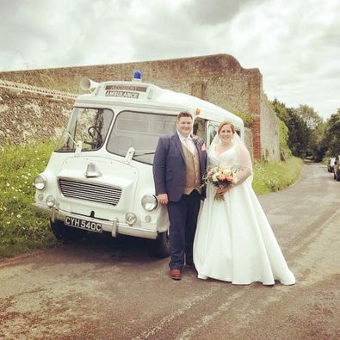
Dr Vince Clarke
Principal Lecturer in Paramedic Science,
University of Hertfordshire
Paramedic
London Ambulance Service NHS Trust
Alex Ulrich
Senior Lecturer in Paramedic Science,
University of Hertfordshire
Advanced Paramedic Practitioner (Critical Care)
London Ambulance Service NHS Trust

Slide 2
Replacing placement with simulation- a product of the pandemic.

Slide 3
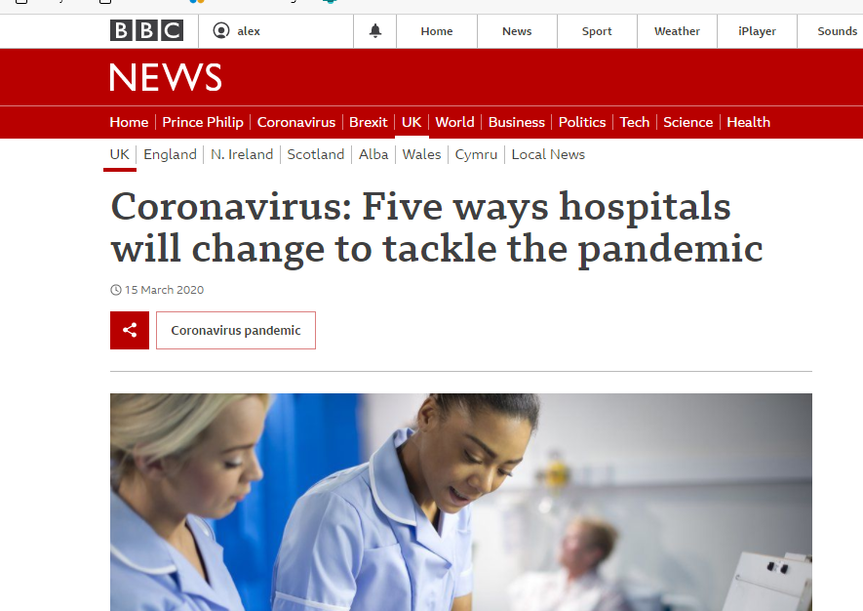
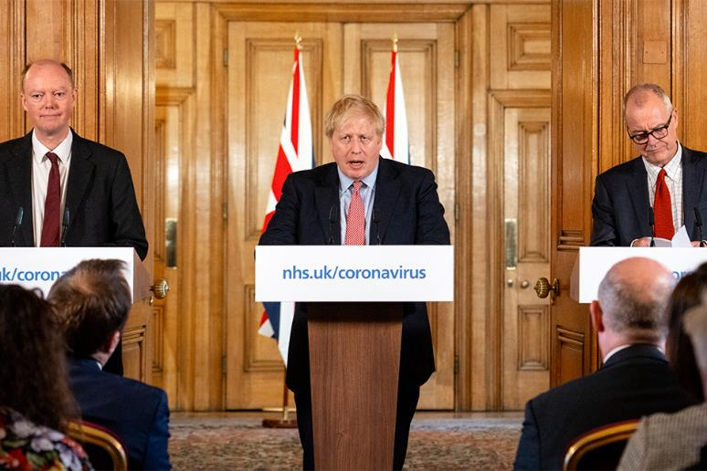
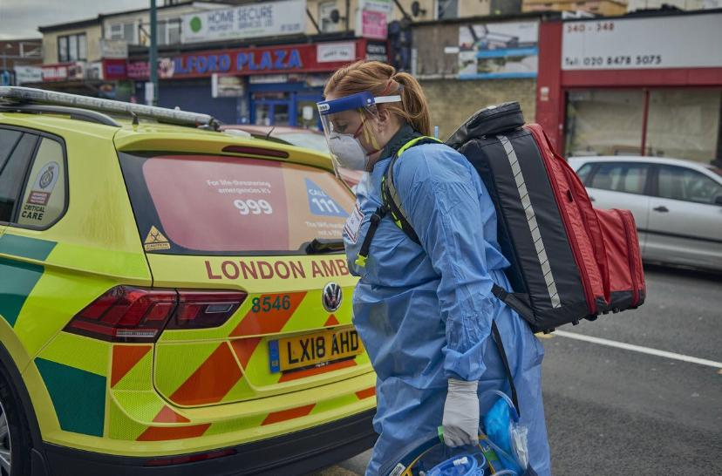
The Problem:

Slide 4
The Problem:
First easing of lockdown restrictions

Slide 5
Our solution: ‘Simulation Fortnight’

Slide 6
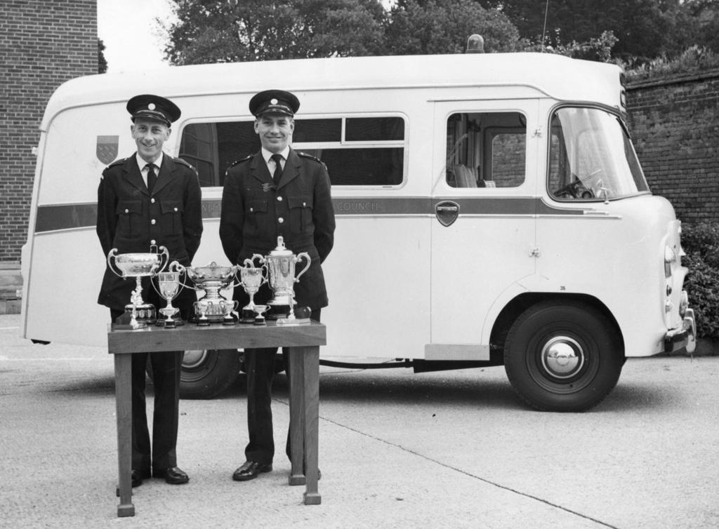
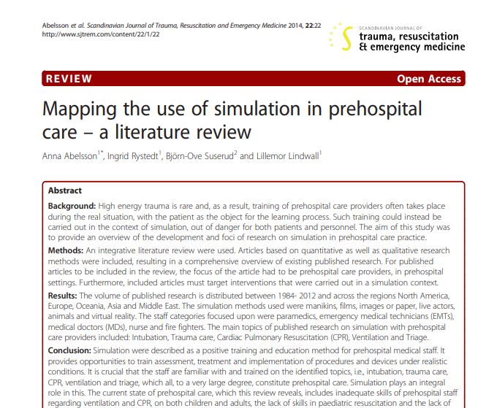
But why simulation?

Slide 7
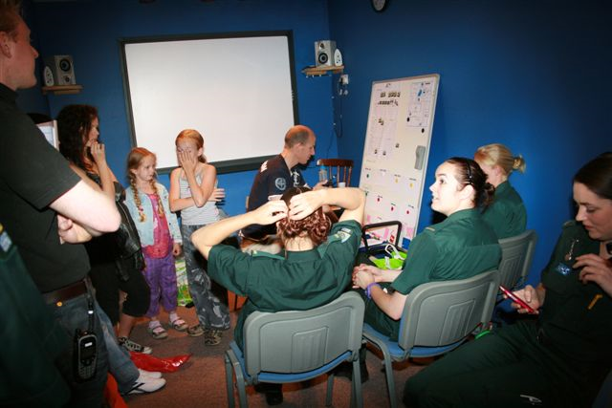
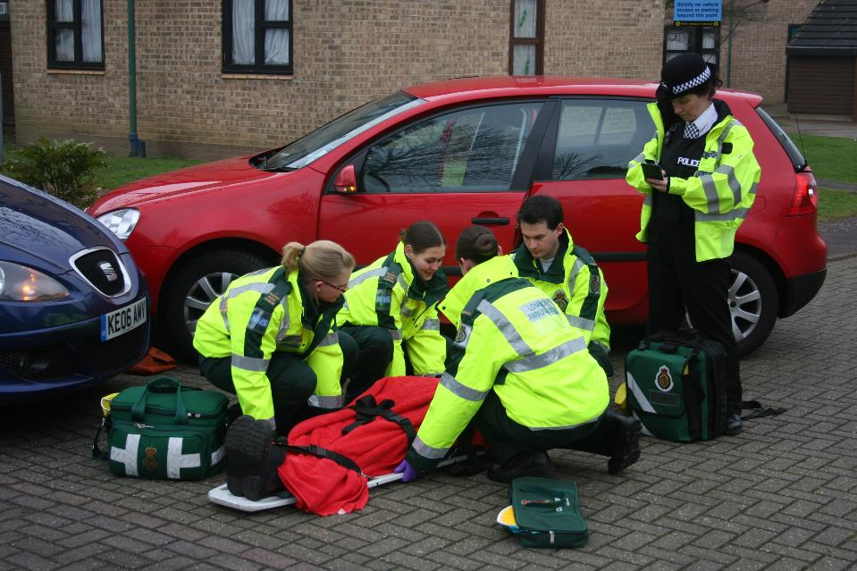
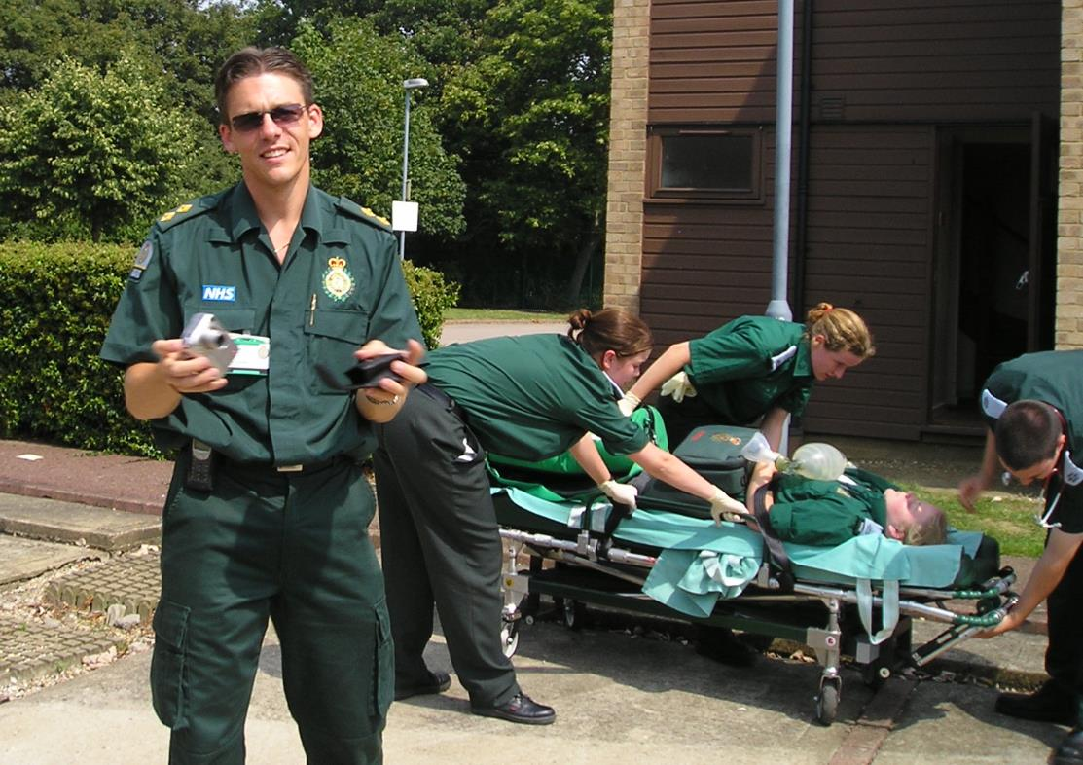
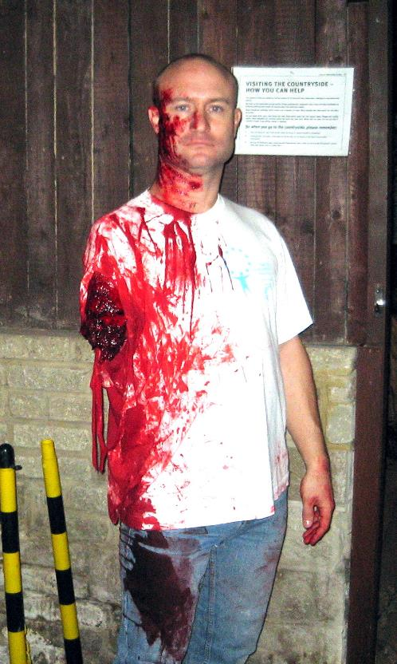
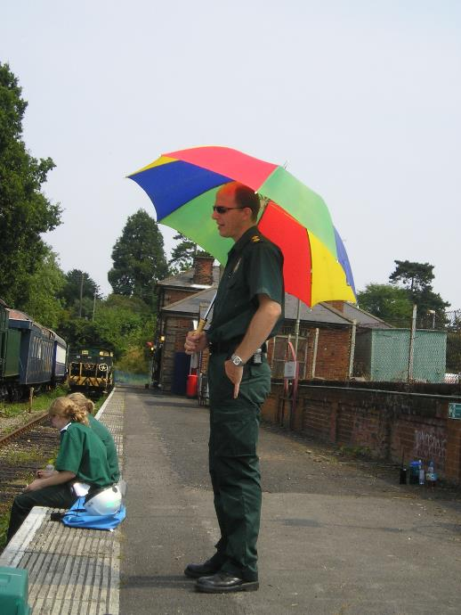
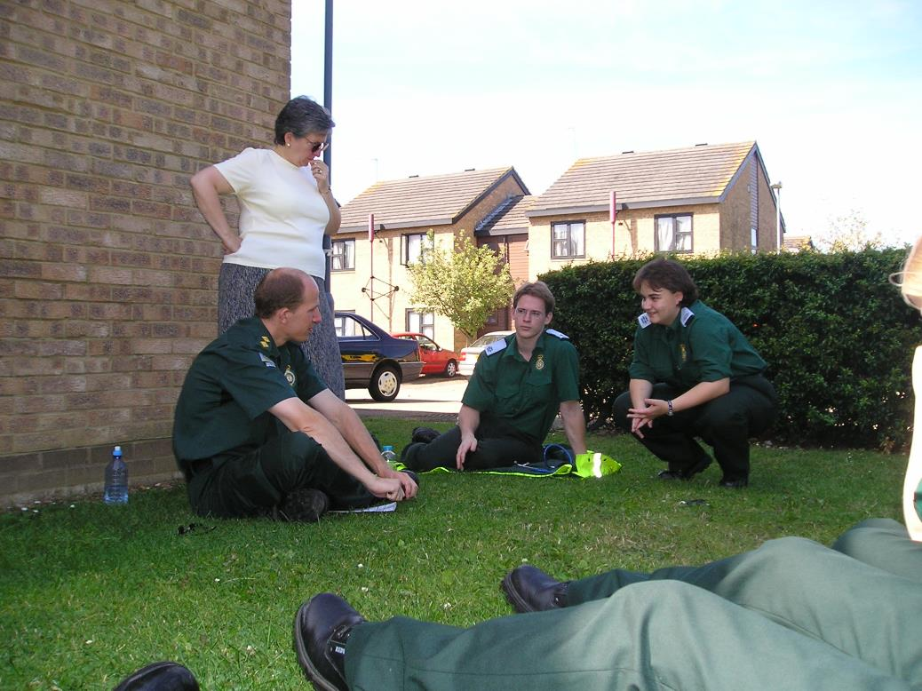
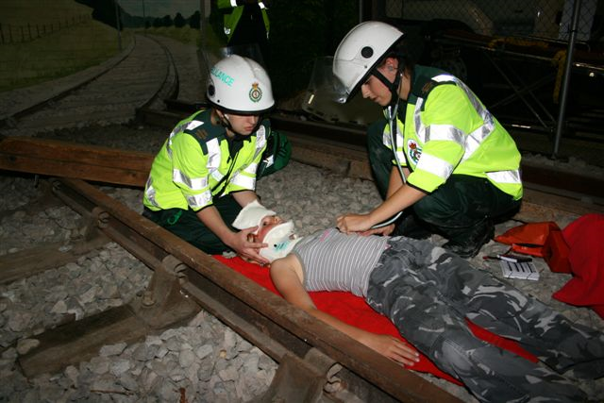
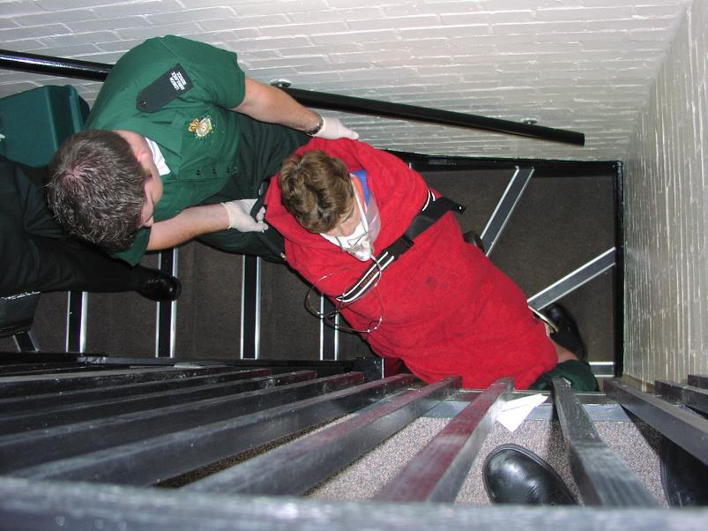
Not a new concept…

Slide 8
Structure and Aims:
Work in small ‘bubbles’ of 8
Rotate around 8 scenarios each day (each person leads at least once a day)
Replicate a day in the life of a Paramedic in a UK based ambulance service
See a variety of cases in terms of acuity and urgency
20 minute scenario, 25 minute debrief
Increasing in intensity throughout the 2 weeks
Culture of learning and improvement
Notes:
Work in small ‘bubbles’ of 8
Rotate around 8 scenarios each day (each person leads at least once a day)
Replicate a day in the life of a Paramedic in a UK based ambulance service
See a variety of cases in terms of acuity and urgency
20 minute scenario, 25 minute debrief
Increasing in intensity throughout the 2 weeks
Culture of learning and improvement

Slide 9
Clinical Scenarios:

Slide 10
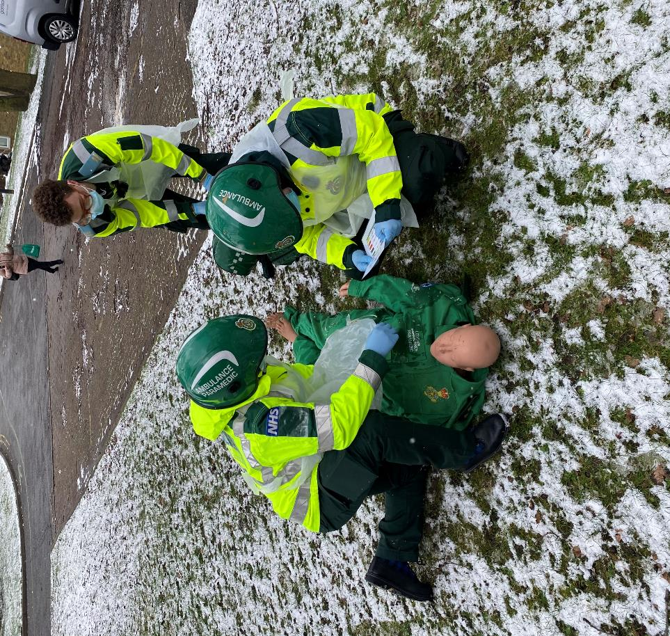
Location & Setting

Slide 11
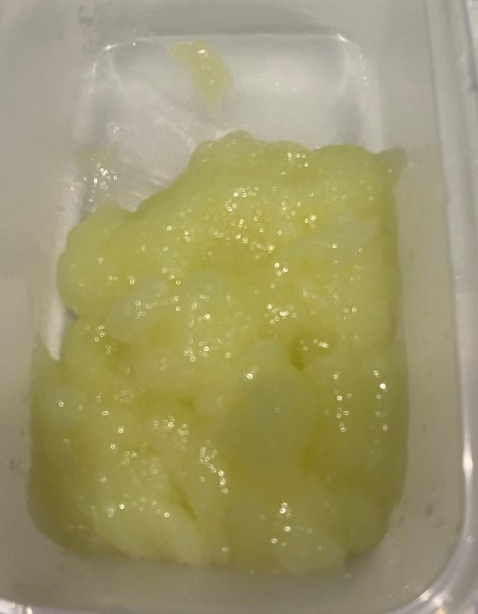
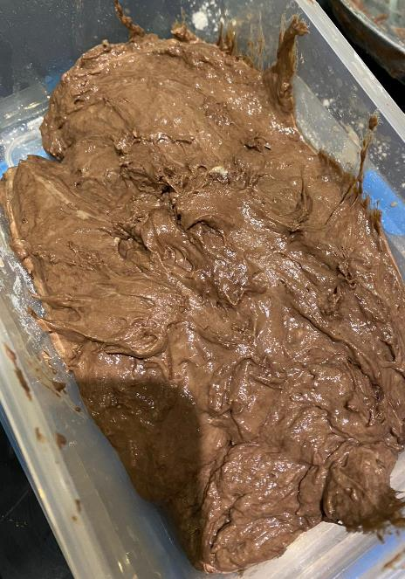
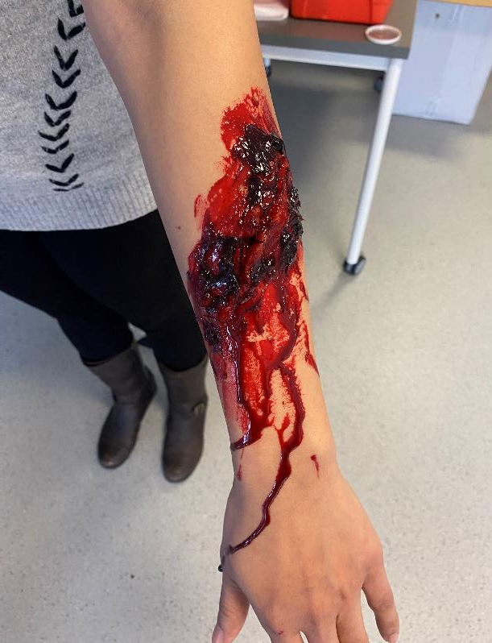
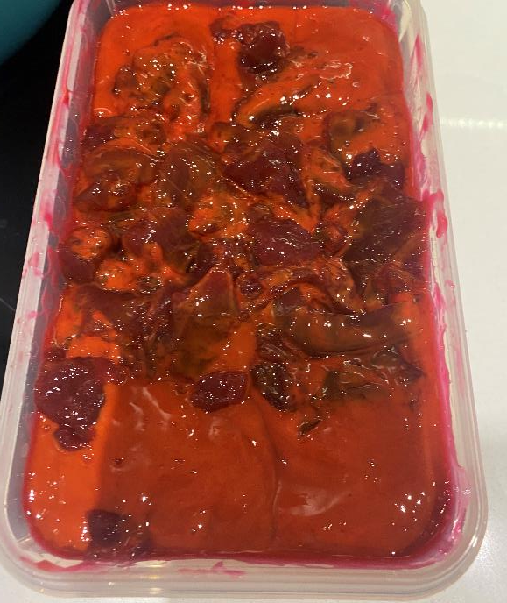
Fidelity of simulation

Slide 12
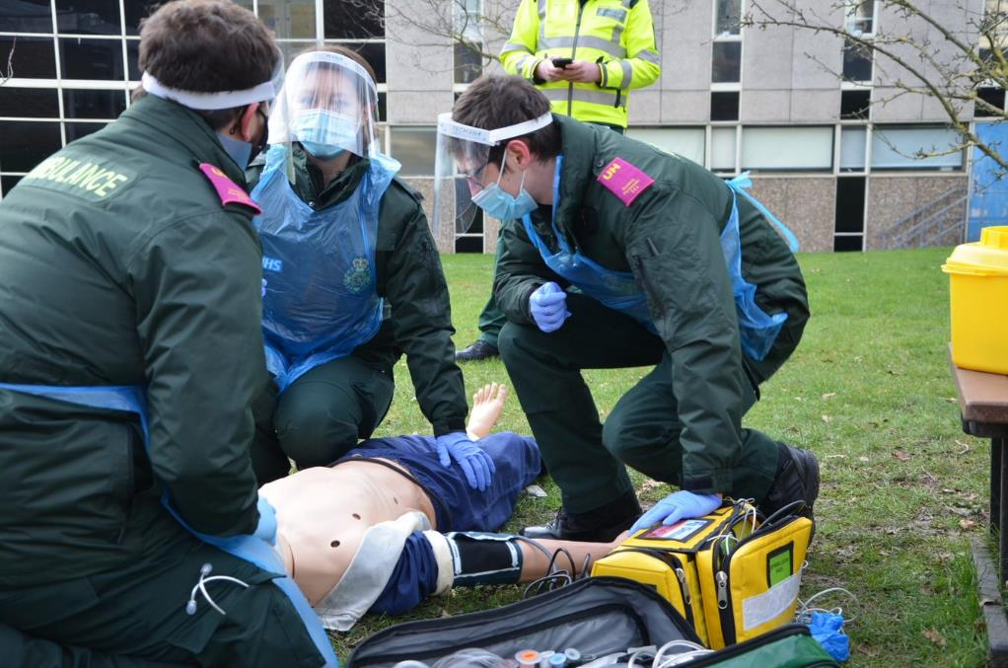
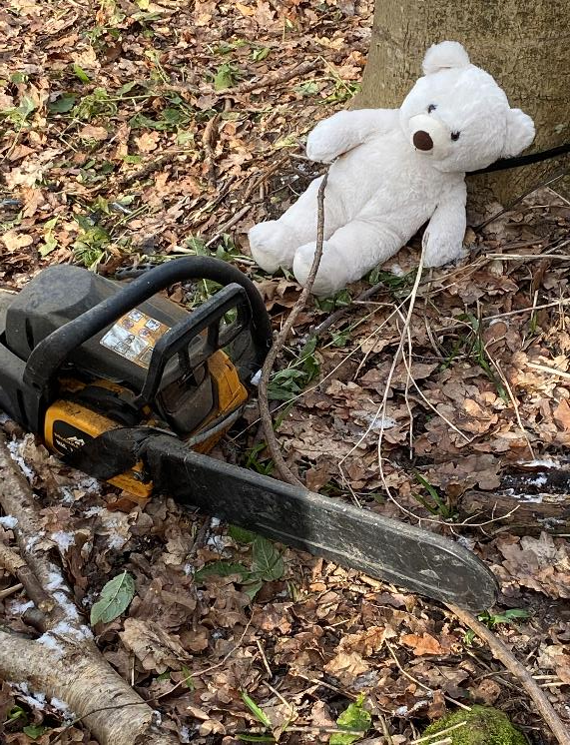
Learning to experience stress

Slide 13
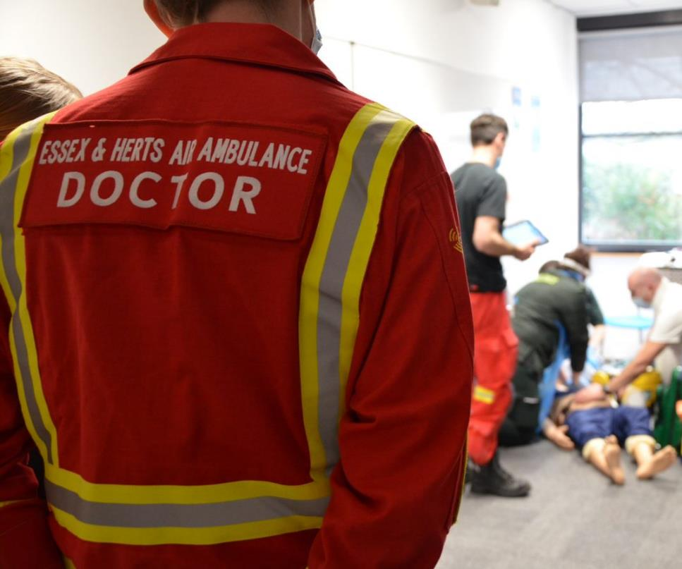
Staffing

Slide 14
Finances:
Hospital placement usually costs £16 per student per day (53 students, two week placement = £6750)
This money was redirected to pay for Visiting Lecturers
Extra funding was obtained from the University of Hertfordshire if we could demonstrate future benefit
Future benefit was achieved by recording simulations to replay to future year groups
Total cost = £10,000

Slide 15
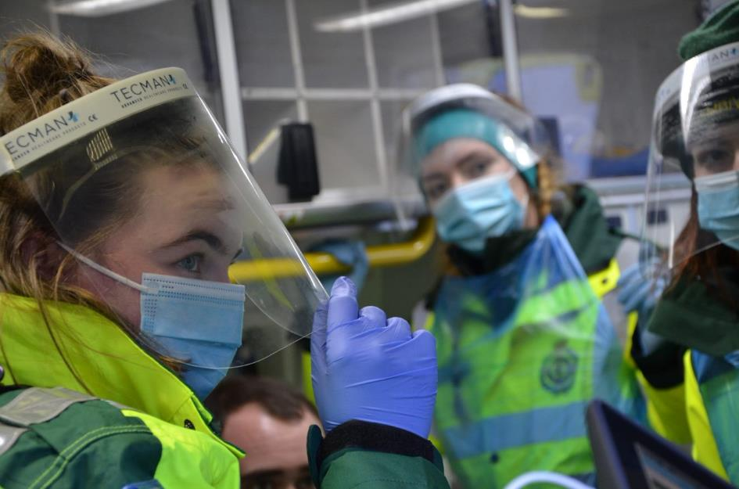
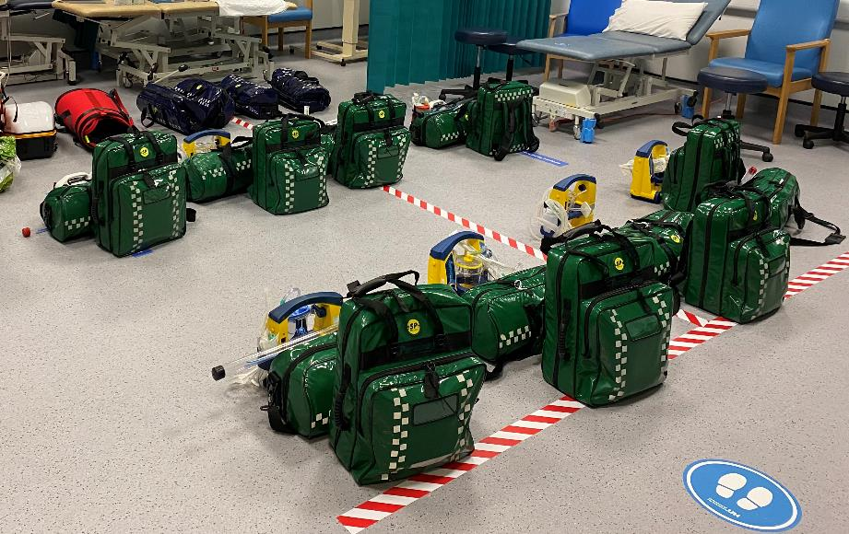
Making Simulation Fortnight COVID-19 ‘secure’

Slide 16
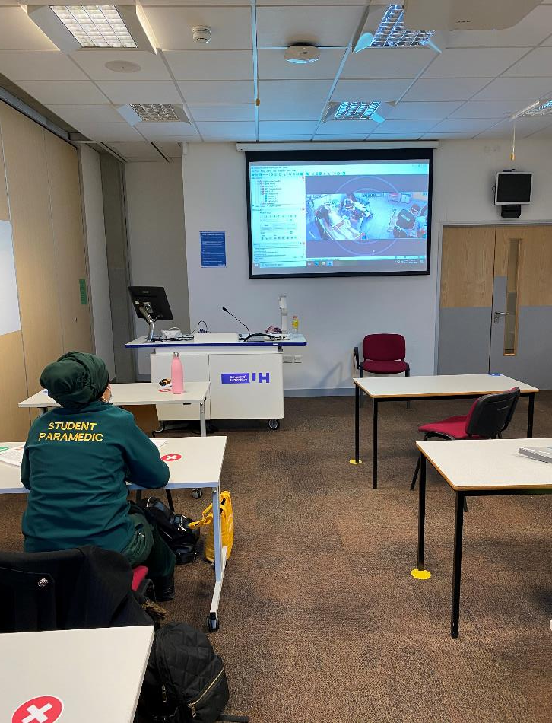
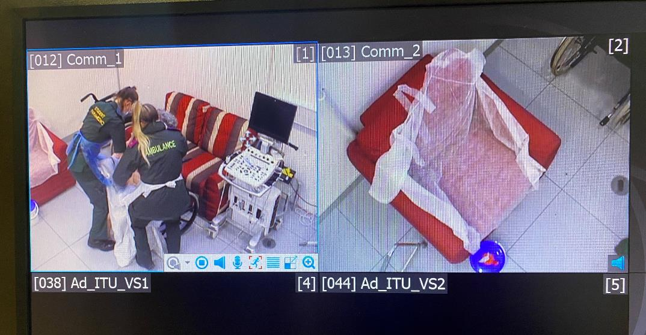
Making Simulation Fortnight COVID-19 ‘secure’

Slide 17
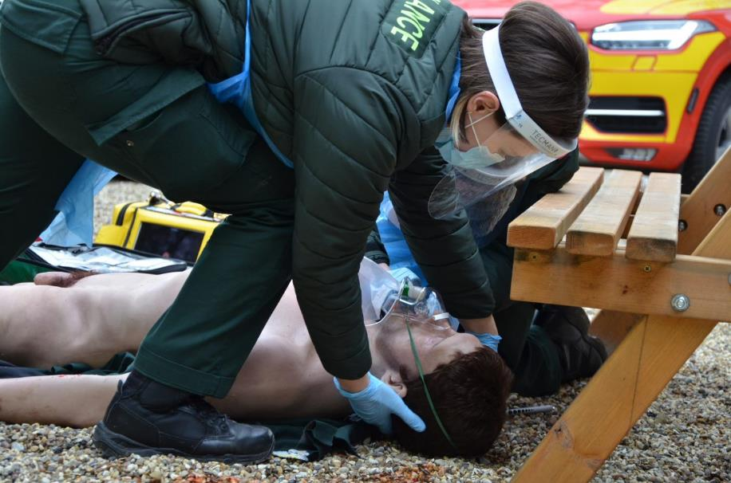
Clinical & Educational Benefit
Notes:
Immersive
Real
Chance to practice clinical skills seldom used on placement
Learn ability to experience and manage stress ‘stress inoculation’
Debrief in a supportive, informative manner- also sometimes not possible on placement especially during a pandemic
Putting theory into practice

Slide 18
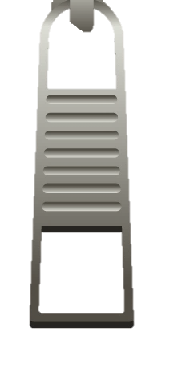
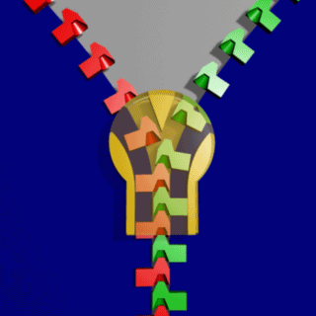
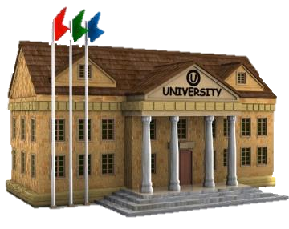
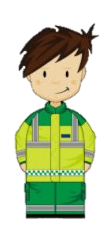
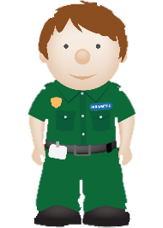
The Zip-analogy
THEORY
PRACTICE
Theory-practice gap?
PARAMEDIC PRAXIS

Slide 19
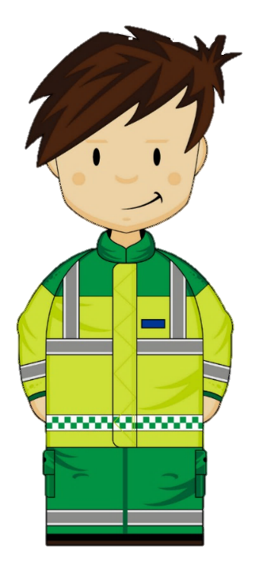
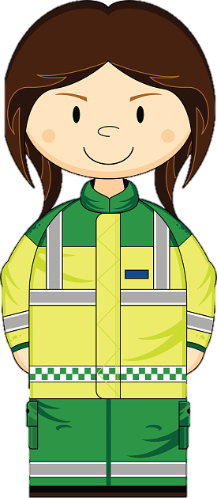
What the students thought:
It has been brilliant and I definitely believe it should be something that should be added to the UH paramedic programme.
It would be great if we could have more!
Simulation Fortnight has genuinely been one of the most valuable learning experiences I have ever had, and has overall been the most incredible experience of my life so far, and I genuinely mean it!
Should be done for every year group!
Honestly, Simulation Fortnight has been the best experience I've had during my time at the university (Both socially and educationally).
A huge thank you! This fortnight has been transformational!

Slide 20
Areas for improvement:
Perhaps short breaks between simulations to allow more time to commute to each room
It would be great if we could have more!
I notice that a lot of students with lower clinical skills and confidence felt insecure close to those who were doing really well
I genuinely feel like there is nothing to be improved. It was so fantastic. Maybe make it longer!

Slide 21
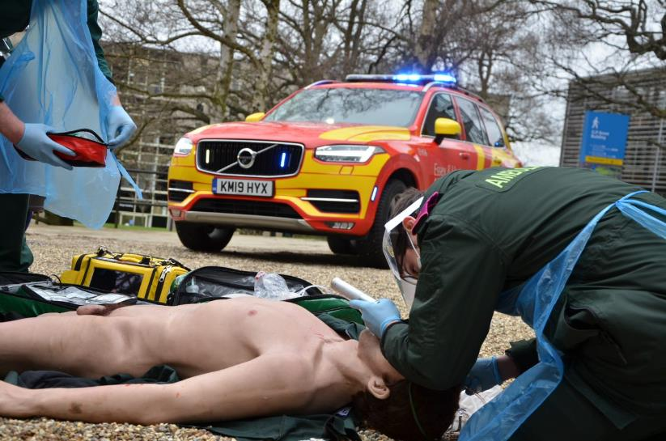
The future?
Vs:

Slide 22
In Summary:
Great things can happen when you are pushed to make a change
Great leaders trust in their staff to get it right
Great teams work together to get it right
Utilise the clinical experience of proven Paramedics
With great enthusiasm and commitment, the students will follow

Slide 23
Thank you

